Slide 1


Supporting Grieving Students in Schools
Notes:
Version August 2019
This “Supporting Grieving Students in Schools” training was divided into three sections or modules so that this education program can be taught in three separate presentations.
The first module will help school staff understand the experience of the grieving student and includes information about how children understand death and express their grief.
The second module presents practical suggestions about how school staff can initiate the conversation and offer support to the grieving student.
The third module presents practical guidance about how to coordinate resources and manage special issues while you support the grieving child.
At the bottom of some of the notes, three stars (***) will alert you about a location on the www.grievingstudents.org website where you can find video presentations and testimonies about the topic being presented.

Slide 2
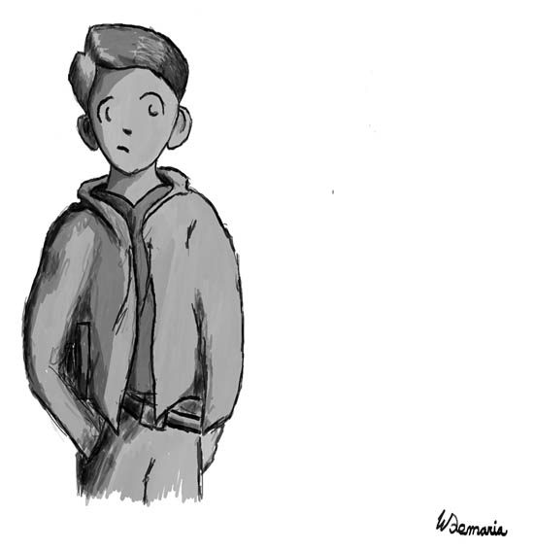
Loss is common in the lives of children
Loss is common in the lives of both younger children and adolescents
About 5% will face the death of a parent by age 16
Almost all children experience the death of an important person in their lives
It’s likely you work with grieving children every day, even if you don’t see any children who appear to be grieving
Notes:
Unfortunately, loss is common in the lives of both younger children and adolescents, and this often includes the loss of someone very close. About 5% will face the death of a parent by age 16. Studies show that before they reach adulthood, almost all children will experience the death of an important person in their lives. For example, in a survey of students in two midwestern high schools, 90% reported the death of a family member, relative or someone they cared about; and 40% reported the death of a close friend their own age.
It’s likely you work with grieving children every day, even if you don’t see any children who appear to be grieving.
Even though loss is common, it can still have a profound effect on children, as demonstrated by the following brief video clip.

Slide 3
Introduction Video
Click for video.

Slide 4

Grief Is Different for Each Child Based on…
• Personal relationship or perceived connection with the deceased
• Prior experience with loss
• Age and level of understanding about death
• Preexisting coping mechanisms
• Method of expressing strong emotions
• Available support systems
• Level of empathy for the needs of others
Notes:
At some level, individuals who are grieving have similar types of needs—such as for acknowledgment, understanding, and support. At another level, however, grief is quite personal. Each student’s personal reactions are likely to be quite varied.
Grief Is different for each child based on their:
Personal relationship or perceived connection with the deceased
Prior experience with loss
Age and level of understanding about death
Preexisting coping mechanisms
Method of expressing strong emotions
Available support systems
Level of empathy for the needs of others

Slide 5

Reactions of Children to Loss
Little or No Reaction
Nonverbal Communication
Anger
Risky Behaviors
Preexisting learning, emotional, or behavioral challenges may resurface or worsen
Acting Younger
Notes:
Reactions to a death vary greatly in children.
Little or No Reaction - Some students appear to have little or no reaction at all after the death of someone important in their lives. They may actually be making an extraordinary effort to keep their emotions hidden from others. Adults in their lives may be unaware of their distress.
Nonverbal Communications - Many children express their feelings in ways other than talking. Very young children often work through their feelings during play. Older children may use creative activities such as writing, role-playing, or art to express their thoughts and feelings. While play and creative activities can provide important clues to children’s thoughts and feelings, adults should be careful not to jump to conclusions. For example, children who draw only happy scenes after a traumatic loss might give the impression they are not affected by the events. In actuality, they may instead be giving a sign that they are not yet ready to process or express their grief. Rather than interpreting children’s play or creative work, consider asking them to describe what their work is about or what story they are telling.
Anger - Children may express anger after a death and look to assign blame to others. These reactions may be an attempt to establish control in response to an overwhelming experience. Children may also direct anger toward the person who died. They may feel abandoned, or be angry about negative consequences and secondary losses that resulted from the death. It is important to normalize feelings of anger and encourage grieving children to express their feelings in ways that aren’t harmful. When children understand that people often feel angry after a death, they are less likely to feel guilty or ashamed of their feelings.
Risky Behaviors - Older children and teens may engage in risky behaviors such as drinking alcohol or using other substances, engaging in risky sexual activity, or participating in violent or delinquent behavior. This often reflects their struggle to master an increase in feelings of personal vulnerability after the death of someone close to them. Invite these students to think about possible links between the risks they are taking and their feelings about their loss. When the risky behaviors persist, or when they are serious, refer students to appropriate mental health professionals.
Preexisting Challenges - Preexisting learning, emotional, or behavioral challenges may resurface or worsen after a death. Help plan extra supports from professionals within the school and community as students learn to cope with their loss.
Acting Younger - In the aftermath of a death, children may begin to act more like they did at an earlier age. Children who were comfortable with independence may become sensitive to separation from surviving family members. They may act more immature, self-centered or demanding, and be less tolerant of change.
*** Other Reactions
https://grievingstudents.org/module-section/other-reactions/

Slide 6
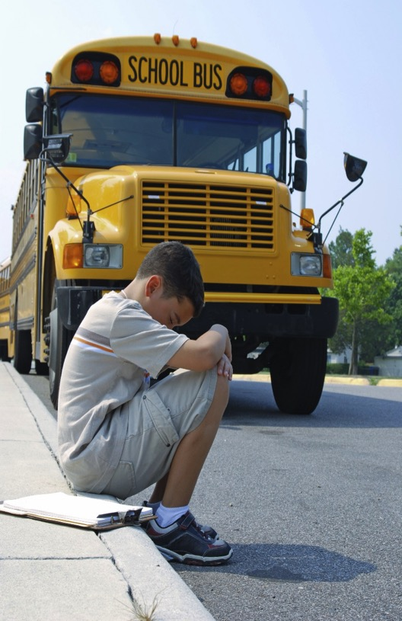
Guilt is Very Common After a Death…
When something bad happens, children often assume they have caused the problem by acting badly
Children may worry about the possibility that they will repeat their bad behavior & cause the death of someone else
The preexisting relationship with the person who died was ambivalent or conflicted
A death is preceded by a lengthy illness
There may be some logical reason to experience guilt feelings
Guilt is More Likely When…
Notes:
Guilt is very common after a death…
When something bad happens, children often assume they have caused the problem by acting badly.
Children may worry about the possibility that they will repeat their bad behavior and cause the death of someone else close – so you may see some children after a death try to act perfectly. We often respond to children’s misbehavior, but any sudden change of behavior after a death should be explored.
Guilt is more likely when…
The preexisting relationship with the person who died was ambivalent or conflicted. This would include when a parent was abusive, absent, mentally ill, drug involved, or incarcerated. It might also stem from developmentally common situations—for example, an adolescent who clashed with her father’s attempts to limit her independence.
If a death is preceded by a lengthy illness. Children (and adults) may have had moments when they wondered whether it might not be best for the person to die and be relieved of the physical suffering. This would also end some of their own emotional suffering as they anticipate the death and adjust to the needs of the sick person. These children may feel guilty for wishing for the death of someone they love.
There may be some logical reason to experience guilt feelings. For example, if a child accidentally discharged a firearm, killing a sibling. It is important to involve mental health providers, either from the school or the community, to help such children address their feelings. Through counseling they may come to appreciate that their guilt is unwarranted, or be helped to forgive themselves if they contributed to an action that resulted in a death.
*** Guilt & Shame
https://grievingstudents.org/module-section/guilt-shame/

Slide 7

Shame Can Be Experienced when Children & Adolescents Believe
Their questions or comments about the deceased make a family member or adult upset.
The person who died did something wrong that resulted in his or her death
Notes:
Another common reaction children have to a death is shame. When children withhold information about a loss or expressions of grief out of shame, they will be even more isolated in their grief.
Shame can be experienced when children believe that:
their questions or comments about the deceased make a family member or others upset. Children may fear that they have done something naughty in broaching the subject and keep their questions and feelings to themselves. This may provide reassurance to the adults in their lives that they are fine even though they continue to have questions and feelings about the death.
the person who died did something wrong that resulted in his or her death. They may then feel ashamed of their relationship with the deceased. Deaths that carry an additional stigma, such as deaths involving suicide, drug overdose, or criminal activity, are therefore even more difficult to discuss. Children and adults may choose not to even inform the school that a significant death has occurred, in part related to feelings of shame or embarrassment.

Slide 8

Supporting Children with Guilt and Shame
Discuss guilt and shame explicitly with grieving children
Ask about the kinds of thoughts, questions, or feelings they have been having
Describe the kinds of reactions related to guilt and shame that people often have
Normalize the experience of guilt and shame while creating a safe environment
Talk to a school mental health professional if these emotions are persistent or causing marked distress
Notes:
Shame and guilt are common reactions among grieving children—and grieving adults as well. School staff can help support children suffering from guilt and shame:
Discuss guilt and shame explicitly with grieving children
Ask about the kinds of thoughts, questions, or feelings they have been having
Describe the kinds of reactions related to guilt and shame that people often have
Normalize the experience of guilt and shame while creating a safe environment where children can speak honestly about their experiences
Talk to a school mental health professional if these emotions are persistent or causing marked distress. A referral is generally indicated if the child’s actions are known to have contributed to a death (e.g. Child accidentally discharged a gun and killed someone).
*** Guilt & Shame
https://grievingstudents.org/module-section/guilt-shame/

Slide 9

Impact on Learning
Difficulty concentrating and distractibility
Limitations in learning and/or remembering new facts or concepts
Failing to hand in assignments or study for exams because of reduced family supervision
Preexisting learning challenges become worse
Notes:
Temporary academic challenges are common among grieving students and should be anticipated. These may occur immediately after the death. They might also first appear weeks or even months later.
Common impacts on learning include:
Difficulty concentrating and distractibility
Limitations in learning and/or remembering new facts or concepts
Failing to hand in assignments or study for exams because of reduced family supervision
Preexisting learning challenges often become worse
*** Impact on Learning
https://grievingstudents.org/module-section/impact-on-learning/

Slide 10
Offer Academic Support Proactively
Change an assignment
Change the focus or timing of a lesson
Reschedule or adapt tests
REACTIVE
PROACTIVE
Notes:
It’s important for school professionals to offer academic support proactively. Don’t wait for students to begin demonstrating academic challenges, or for academic challenges to become academic failure. Schools can be a source of valuable support to grieving students and should not become another source of distress.
Assist grieving students in identifying the level of academic work that feels appropriate and achievable. Some helpful modifications include:
• Change an assignment. There are many ways to adapt assignments to better match grieving students’ current ability to focus. For example, allow a student to work on a project with a partner rather than solo. Suggest a student adapt a formal research paper into a more engaging assignment, such as an oral history project or a video. Offer a student the chance to defer an oral presentation and submit a written assignment instead.
• Change the focus or timing of a lesson. A literature class might choose a different book to discuss if the one originally scheduled describes a death similar to the one a student is currently grieving. A health class on the dangers of substance abuse might be postponed, or the grieving student excused, if he has just lost a sibling to a drug overdose.
• Reschedule or adapt tests. Immediately after a death, students might be exempted from some testing, or given modifications such as testing alone in a quiet location with extra time. Scores might be omitted or weighted less in determining final grades. It’s important for teachers to find a balance between maintaining reasonable expectations and providing additional support and accommodation for grieving students. Students need to be appropriately prepared to move ahead to their next grade.
*** Impact on Learning
https://grievingstudents.org/module-section/impact-on-learning/

Slide 11

Types of Losses
Primary Loss: the death of a family member, close friend or loved one
Secondary Loss: Such things as changes in relationships, schools, family finances, and lifestyle
Cumulative Loss: Results following a number of successive losses experienced by a child over time
Notes:
There are multiple types of losses that may occur after a death. The primary loss may be the death of a family member, close friend or other loved one.
When a close family member dies, children may also experience a range of secondary losses that contribute to the difficulty of adjusting to the death. Such things as changes in relationships, schools, family finances, and lifestyle may be secondary losses. Grieving children mourn not only the loss of the person who died, but also these associated losses.
Cumulative loss results from a number of successive losses experienced by a child over time. The child often does not have the opportunity to fully process the impact of primary or secondary losses since other additional losses also occupy their attention.
*** Secondary & Cumulative Losses
https://grievingstudents.org/module-section/secondary-cumulative-losses/

Slide 12
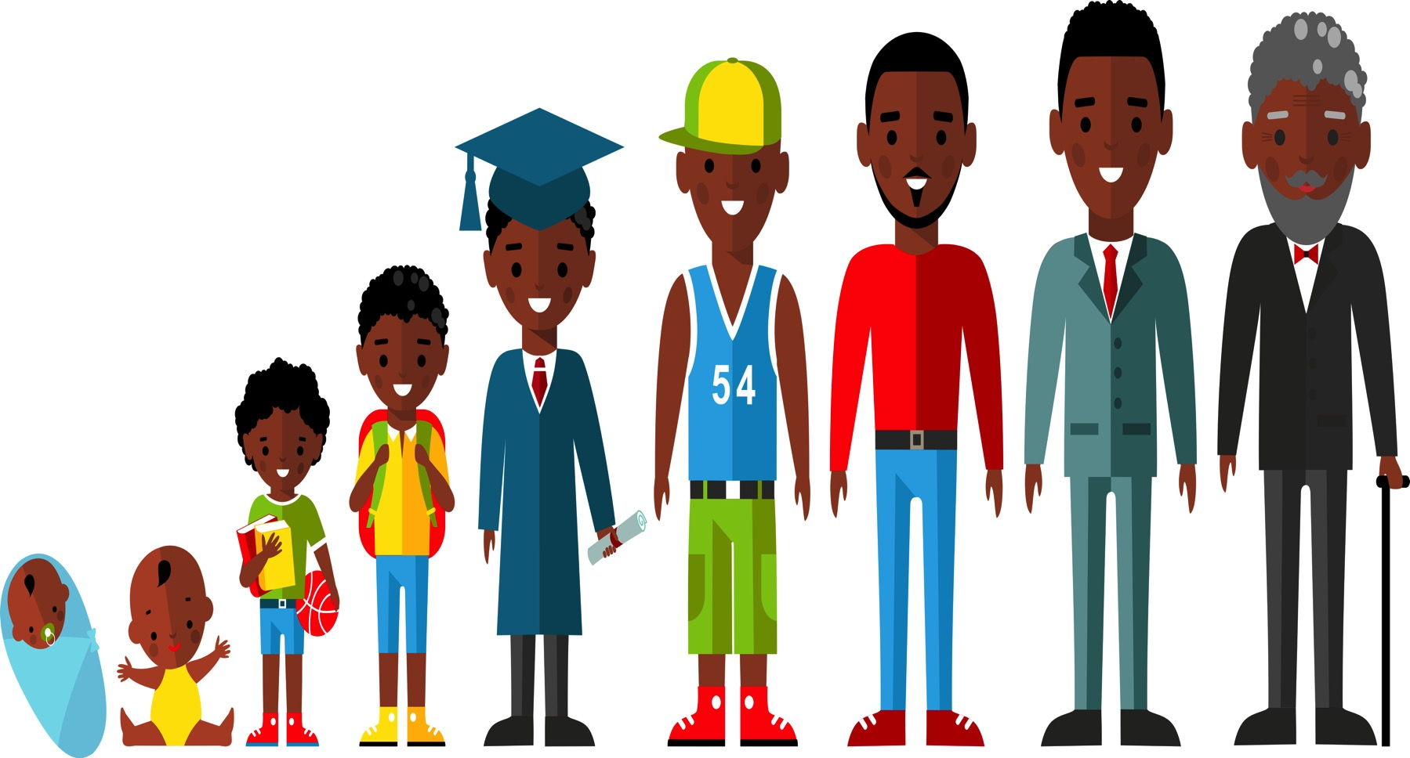
Grief Over Time
Grief proceeds on its own terms
As children grow and develop, even normative transitions and changes in their lives will remind them of the loss
As children develop, they become more capable of understanding and adjusting to their loss
Children experience grief differently over time, and often revisit deep feelings at special events and times of transition
Notes:
Grief proceeds on its own terms. There is no set time frame. There are no firm stages. The second year after a death can seem even more challenging than the first. However, this is a point where the support and concern available immediately after a death has diminished greatly—sometimes it has virtually disappeared. In many ways, children never get over a significant loss.
As children grow and develop, even normative transitions and changes in their lives will remind them of the loss. A boy whose father died while he was in elementary school may miss him acutely when he enters puberty or transitions to college, at college graduation, when he is married, and when he has children or grandchildren.
As children develop, they become more capable of understanding and adjusting to their loss. The work of grieving becomes less difficult and requires less energy. It begins as a full-time job, but becomes more of a part-time effort that allows other meaningful work and experiences to occur. Grieving lasts a lifetime, but does not need to consume a life.
Children experience grief differently over time, and often revisit deep feelings at special events and times of transition. It can be helpful when teachers make a special effort to connect with students at such moments. These may include: holidays, birthdays, moves to a new grade or school and awards and other recognition.

Slide 13
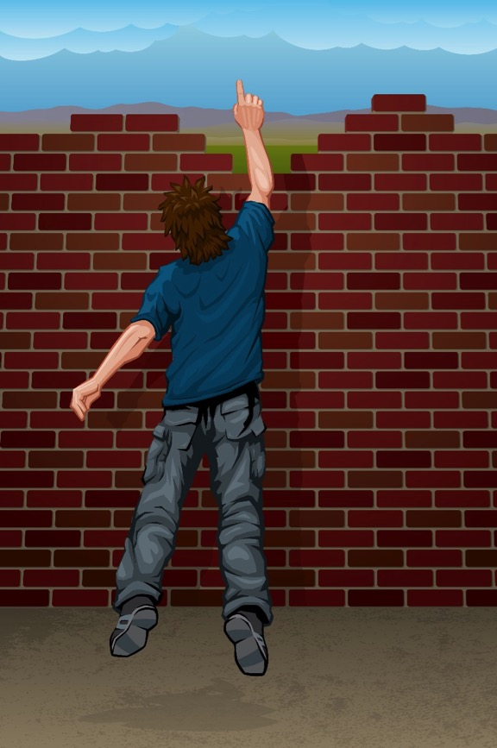
Barriers for Children in Talking About Loss
Children may…
Conclude they have done something wrong by talking about death and avoid raising the subject again
Hold in their feelings as a way to support their family
Try to look fine and reassure family they are okay when they really need support
Not fully understand death and loss
Have problems expressing their complicated feelings
Feel overwhelmed by the experience and their strong feelings
Notes:
Children often feel reluctant to talk about grief. There are some barriers that may prevent children from talking about their loss.
Children may…
Conclude they have done something wrong by talking about death and avoid raising the subject again. Children learn from an early age that conversations about death make people uncomfortable. If they ask questions, people may look away or not continue the conversation. If they speak to grieving family members after a death, adults may cry or show distress.
Hold in their feelings as a way to support their family
Try to look fine and reassure family they are okay when they really need support
Not fully understand death and loss
Have problems expressing their complicated feelings
Feel overwhelmed by the experience and their strong feelings. They may worry that they will lose control, or feel ashamed of these deep emotions. They may have complicated feelings, such as guilt or shame.
*** Why you should reach out to grieving students?
https://grievingstudents.org/module-section/talking-with-children/

Slide 14

How to Act
• Be present and authentic
• Listen more, talk less
• Avoid trying to “cheer up” students or their families
• Accept expressions of emotion
• Show empathy
• Don’t be afraid to show emotions
• Step in to stop harmful behaviors when safety is a concern
Notes:
The following actions will increase children’s comfort, sense of safety, and ability to express themselves:
Be present and authentic.
Listen more, talk less. Keep your own comments brief. Ask open-ended questions to help students discuss their experiences, thoughts, and feelings.
Avoid trying to “cheer up” students or their families. Grief is painful. Attempts to cheer people up or bring focus to the good things in their lives are likely to communicate that you don’t want to hear students or their families talk about their pain.
Accept expressions of emotion. Expressions of sadness, anger, selfishness, or confusion are common in grieving children. These are an important part of the process. When children hear they should “toughen up” or “be strong for their families” they are less likely to fully express their feelings of grief.
Show empathy. Reflect back what you hear students say and the actions you observe. Use compassion. Avoid judgment.
Don’t be afraid to show emotions. Students usually appreciate concerned adults showing they are touched by their loss and/or how the student is feeling, such as by the adult appearing sad or becoming tearful for a moment.
Step in to stop harmful behaviors when safety is a concern.
*** Talking With Children – Chapter 3. Navigating reluctance and communicating with empathy.
https://grievingstudents.org/module-section/talking-with-children/
Teachers and other school staff can do a great deal to help a grieving student cope, without trying to provide counseling – simply offering support and understanding. The following video clip illustrates how a supportive and empathic teacher helped one student after the death of his mother.

Slide 15
A supportive and empathic teacher
Click for video.

Slide 16
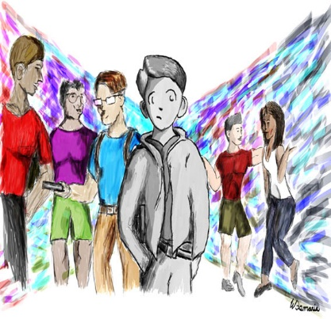
Goals of Support
Decrease the sense of isolation
Increase academic function
Increase the likelihood children will talk with their families
Increase the likelihood children will talk with and receive support from their peers
Identify problems in the family
Connect with students on something of immense importance
Notes:
The primary goal is to offer support in the areas most likely to present challenges to students after the death of a family member or friend. Teachers can take steps to:
Decrease the sense of isolation. When teachers talk about death in the classroom, both as part of regular coursework and in response to a recent event, all students learn more about how to give and receive support.
Increase academic function. It’s common for grieving children to have difficulty concentrating and have a drop in academic performance. Teachers who talk with children and make appropriate adjustments to their class work can help them stay on course academically.
Increase the likelihood children will talk with their families. When children experience support and understanding from teachers, they may find it easier to turn to other adults, including their family members, for support.
Increase the likelihood children will talk with and receive support from their peers. Through classroom discussions and one-on-one conversations, teachers can model understanding and give all students better opportunities to listen, understand, and express feelings among their peers. Students usually appreciate concerned adults showing they are touched by the event and/or how the student is feeling, such as by the adult appearing sad or becoming tearful for a moment.
Identify problems in the family. During talks with teachers, students may reveal family issues, such as a parent struggling with depression. Teachers can help arrange appropriate referrals for the family.
Connect with students on something of immense importance. These are the kinds of lessons and conversations that can genuinely transform children’s lives.

Slide 17

Initiating the
Conversation
Limit personal sharing
Offer practical advice
Offer reassurance
Maintain contact
Express concern
Be genuine
Invite the conversation
Listen and observe
Notes:
Some students may still be reluctant to talk about the death. These steps can help get the conversation started:
Express concern. Let students know you’ve heard about their loss and are available to listen and offer support.
Be genuine. Children can tell when adults are authentic in their communications. For example, don’t tell a child you will miss her uncle if you did not know the man. Do tell the child you are sad she has experienced this loss.
Invite the conversation. Use simple, direct, open-ended questions. For example, ask, “How are you and your family doing?”
Listen and observe. Listen more and talk less. Share observations about students’ behavior or responses in a nonjudgmental manner.
Limit personal sharing. You can draw on personal experiences to help you better understand students, but do not need to share this with them. Keep the focus on the student.
Offer practical advice. For example, discuss ways to respond to questions from peers or adults about the death.
Offer reassurance. Without minimizing their concerns, let students know that over time they will be better able to cope with their distress, and that you will be there to help them.
Maintain contact. At first, children may not accept your invitation to talk or offers of support. Their questions will evolve over time. Remain accessible, concerned, and connected.
*** Talking With Children – Chapter 2. Strategies for starting the conversation.
*** Talking With Children – Chapter 4. Simulated encounters. Examples of four simulated encounters using actors which illustrate conversations between educators and students of different ages and demonstrate issues to consider when initiating conversations.
https://grievingstudents.org/module-section/talking-with-children/

Slide 18
What not to say…
Don’t Say This | Say this instead
“I know just what you’re going through.” | “Can you tell me more about what this has been like for you?”
“You must be incredibly angry.” | “Most people have strong feelings when something like this happens to them. What has this been like for you?”
“This is hard. But it’s important to remember the good things in life, too.” | “What kinds of memories do you have about the person who died?”
“At least he’s no longer in pain.” | “What sorts of things have you been thinking about since your loved one died?”
Notes:
Many school professionals worry they may say the wrong thing to grieving students and make matters worse. Remember, a student’s grief and pain are caused by the death, not by talking about it with a caring adult. Understanding what not to say will help you be more confident and effective when you reach out to students. The suggestions can help you support grieving children.
1. “I know just what you’re going through.” - You cannot know this. Everyone’s experience of grief is unique.
Say this instead: “Can you tell me more about what this has been like for you?”
2. “You must be incredibly angry.” - It is not helpful to tell people how they are feeling or ought to feel. It is better to ask. People in grief often feel many different things at different times.
Say this instead: “Most people have strong feelings when something like this happens to them. What has this been like for you?”
3. “This is hard. But it’s important to remember the good things in life, too.” - This kind of statement is likely to quiet down true expressions of grief. When people are grieving, it’s important they be allowed to experience and express whatever feelings, memories, or wishes they’re having.
Say this instead: “What kinds of memories do you have about the person who died?”
4. “At least he’s no longer in pain.” - Efforts to “focus on the good things” are more likely to minimize the student or family’s experience (see above). Any statement that begins with the words “at least” should probably be reconsidered.
Say this instead: “What sorts of things have you been thinking about since your loved one died?”
*** What not to say.
https://grievingstudents.org/module-section/what-not-to-say/

Slide 19
Don’t Say this | Say this instead
“I lost both my parents when I was your age.” | “Tell me more about what this has been like for you.”
“You’ll need to be strong now for your family. It’s important to get a grip on your feelings.” | “How is your family doing? What kinds of concerns do you have about them?”
“My dog died last week. I know how you must be feeling.” | “I know how I’ve felt when someone I loved died, but I don’t really know how you’re feeling. Can you tell me something about what this has been like for you?”
Notes:
5. “I lost both my parents when I was your age.” - Avoid comparing your losses with those of students or their families. These types of statements may leave children feeling that their loss is not as profound or important.
Say this instead: “Tell me more about what this has been like for you.”
6. “You’ll need to be strong now for your family. It’s important to get a grip on your feelings.” - Grieving children are often told they shouldn’t express their feelings. This holds children back from expressing their grief and learning to cope with these difficult feelings.
Say this instead: “How is your family doing? What kinds of concerns do you have about them?”
7. “My dog died last week. I know how you must be feeling.” - It is not useful to compare losses. Keep the focus on grieving children and their families.
Say this instead: “I know how I’ve felt when someone I loved died, but I don’t really know how you’re feeling. Can you tell me something about what this has been like for you?”

Slide 20

Checking a Child’s Understanding of Death
Start by asking children what they understand about death
Give them simple, direct and developmentally-appropriate explanations
Ask them to explain back to you what they understand
Correct any misunderstandings or misconceptions.
Notes:
When discussing a death, it’s useful to check children’s understanding of the Four Concepts About Death. These steps will be helpful:
Start by asking children what they understand about death.
Give them simple, direct and developmentally-appropriate explanations. Less direct terms may be confusing. For example, if children hear someone who died is in a state of eternal sleep, they may be afraid to go to sleep. Especially with younger children, it’s important to use the terms dead and died.
Ask them to explain back to you what they understand.
Correct any misunderstandings or misconceptions. These steps will help make any misunderstandings clear.
*** Concepts of Death
https://grievingstudents.org/module-section/concepts-of-death/

Slide 21
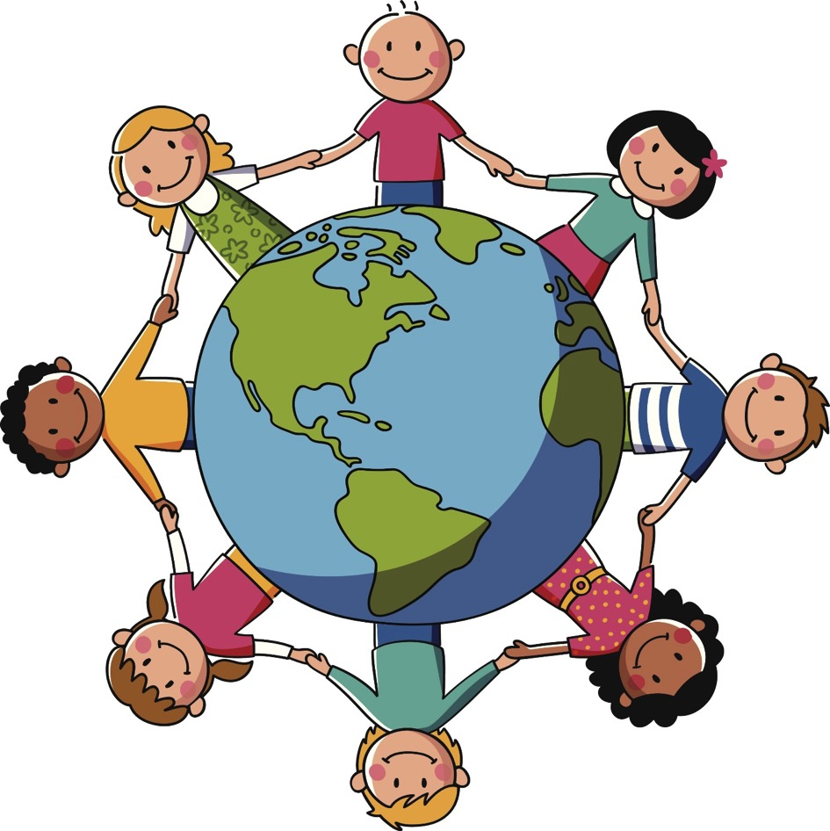
Cultural Sensitivity
Remember that the fundamental experience of grief is universal
Ask questions
Ask openly when you are unsure what would be most helpful for a family or individual
Watch out for assumptions
Be empathetic, thoughtful and sensitive
Notes:
It is understandable that school personnel may not be familiar with the rituals and expectations of every culture represented among their students. The following suggestions will help you maintain a sensitivity about grief in all cultures:
Although these are real differences, remember that the fundamental experience of grief is universal. Families from different cultures may follow specific traditions, rituals, and practices after a death. Rather than attempting to gain knowledge about every culture, teachers can aspire to achieve a general sensitivity to the unique needs of children and families coping with loss.
Ask questions.
Ask openly when you are unsure what would be most helpful for a family or individual. For example: “Can you tell me how your family and your culture recognize and cope with the death of a family member?, How does this fit with your own preferences at this time?”, “Can you help me understand how I can best be of help to you and your family?”
Watch out for assumptions. Even if you know about the common practices of a culture, this may not accurately predict how a family or individual from that culture will behave. Many people have been exposed to multiple cultures. Parents sometimes have different beliefs or practices from their children. Some families or individuals choose to follow practices of a different culture when these align better with their current beliefs or preferences. Assumptions may result in stereotypes that cloud our perceptions and make us miss opportunities to be helpful.
Be empathetic, thoughtful & sensitive. Even if you don’t know about a particular culture’s practices concerning death and grief, you can approach the family with an open mind and heart. Be guided by their responses.
*** Cultural Sensitivity
https://grievingstudents.org/module-section/cultural-sensitivity/

Slide 22

Common Grief Triggers
• Hearing a song or seeing a TV show
• Special occasions
• Transitions
• Lost opportunities
Notes:
Grief triggers are sudden unanticipated reminders of the person who died that may cause powerful emotional responses in grieving children, such as:
• Hearing a song or seeing a TV show that reminds the child about a missing family member
• Special occasions (e.g. holidays, birthdays, Mother’s or Father’s Day)
• Transitions such as graduation, starting at a new school, or moving, when the presence of a friend or family member may be particularly missed
• Lost opportunities for special interactions with the person who died such as school performances, sports events, father-daughter dances
Grief triggers catch children off guard, may make them feel out of control or embarrassed and temporarily interfere with their ability to concentrate and learn.
*** Grief Triggers
https://grievingstudents.org/module-section/grief-triggers/
The following video clip illustrates the impact of grief triggers.

Slide 23
Grief triggers
Click for video.

Slide 24

Preparing Students to Manage Grief Triggers
Identify a safe space or location where the student can go
Provide the child with the name of an adult he or she can see when feeling upset or wishing to talk
Set up procedures that allow the student to obtain support
Allow the child to call a parent or family member
Give permission and encouragement for the child to speak with other school staff
Offer private time to talk over feelings, questions, or other concerns
Notes:
Grief Triggers are most common in the first few months after the death, but may happen at any time. School professionals can prepare students with information about grief triggers, proactively establish a safety plan with grieving students, and approach potentially difficult classroom lessons or activities with increased awareness. This creates a more supportive classroom environment that is appreciated by all students.
Support from teachers and schools can help students move through these experiences in a positive and productive way. Ideally, there will be a chance to explain proactively to grieving children that it is fairly common for such triggers to occur. Reassure them that, while intense, the immediate distress will pass. School professionals can work with a child to develop a plan for grief triggers.
Options include:
• Identify a safe space or location where the student can go. This might be the library, a study hall, a nearby classroom, or the office of the school counselor, school nurse, school psychologist, or school social worker.
• Provide the child with the name of an adult he or she can see when feeling upset or wishing to talk.
• Set up procedures that allow the student to obtain support, such as a signal or statement that doesn’t draw attention but does allow the student to leave the classroom. It’s difficult for children to ask for help and expose their vulnerabilities in front of peers when they are already feeling overwhelmed.
• Allow the child to call a parent or family member.
• Give permission and encouragement for the child to speak with other school staff including the school counselor, school nurse, school psychologist, or school social worker.
• Offer private time to talk over feelings, questions, or other concerns.
When children know there is a plan in place to deal with grief triggers, they feel less trapped when they occur. If children know they can leave without drawing attention to themselves, they become less anxious. Their distress passes more quickly, and they rarely need to leave the classroom. They are more likely to remain in class and be available for learning.
*** Grief Triggers
https://grievingstudents.org/module-section/grief-triggers/

Slide 25

Anticipate & Minimize Triggers
Expect that triggers may occur around holidays, Mother’s Day and Father’s Day, the child’s birthday, the birthday of the deceased, or the anniversary of the person’s death
Introduce class activities in a way that acknowledges absences and offers alternatives
Make an effort to reach out to grieving students at school events where the absence of a loved one may be especially noticeable
Introduce subjects such as serious illness, accidental death, war, or violence with sensitivity
Notes:
When possible, it’s helpful to anticipate and minimize grief triggers. Here are some steps that will help:
• Expect that triggers may occur around holidays, Mother’s Day and Father’s Day, the child’s birthday, the birthday of the deceased, or the anniversary of the person’s death. Children and their families may be able to suggest dates that may be difficult.
• Introduce class activities in a way that acknowledges absences and offers alternatives. Example: “For this Father’s Day activity, I’d like you to focus on your father or another important male adult in your life— someone who cares for you and has provided support. If your father is not living, or he does not live with you, you can still complete this activity with him in mind if you wish.”
• Make an effort to reach out to grieving students at school events where the absence of a loved one may be especially noticeable (e.g. performances, sporting events, science fairs).
• Introduce subjects such as serious illness, accidental death, war, or violence with sensitivity. Recognize that students in your class may have lost a family member or close friend in one of these ways.

Slide 26
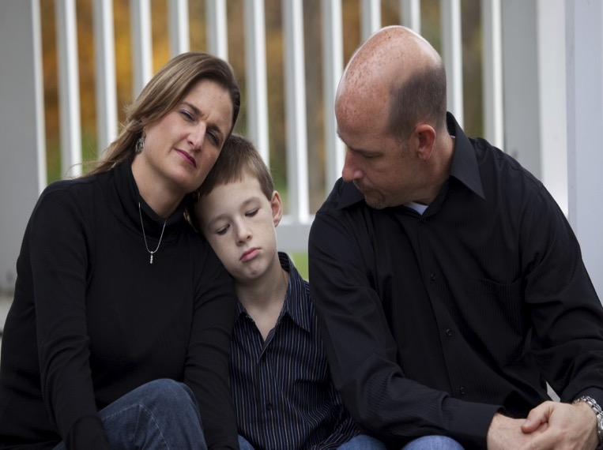
Connecting With Grieving Families
Express condolences on behalf of the school community
Determine what information they wish shared with students and staff
Check-in with the family about your efforts to support the child and ask for assistance in identifying what the child knows or does not know about the death
Let the family know the professional resources of the school are available
Offer advice on how to support grieving children
Remind parents of their critical role in supporting their children at this time
Notes:
Teachers and other school staff play a vital role when they reach out proactively to make contact with students’ families after a death. They can provide information, find out how students are doing, offer advice and assistance, and partner with families to provide support over time.
Goals for Communication With Families:
Express condolences on behalf of the school community. Recognize that some families will decline offers to meet, speak, or receive assistance —especially at first. Re-extend the invitation occasionally and keep the door open, should the family become ready at a later time.
Determine what information they wish shared with students and staff. Grieving families may need guidance about how important it is to share information about a death. Clear information can help prevent the spread of rumors and misinformation.
Check-in with the family about your efforts to support the child and ask for assistance in identifying what the child knows or does not know about the death
Let the family know the professional resources of the school are available. It is appropriate for schools to initiate contact with students’ families after a death occurs. Parents may be overwhelmed by events and may not think of their children’s school as a resource for information, guidance, and support.
Offer advice on how to support grieving children. Parents may appreciate guidance on what to say to their children about the death. School personnel are often involved early enough to provide advice on funeral attendance.
Remind parents of their critical role in supporting their children at this time. Let parents know their children may be worried about them, and are looking to them for guidance on how to cope. You may be able to equip the family with needed information and advice that allows them to better fulfill this role.
*** Connecting With Families
https://grievingstudents.org/module-section/connecting-with-families/

Slide 27
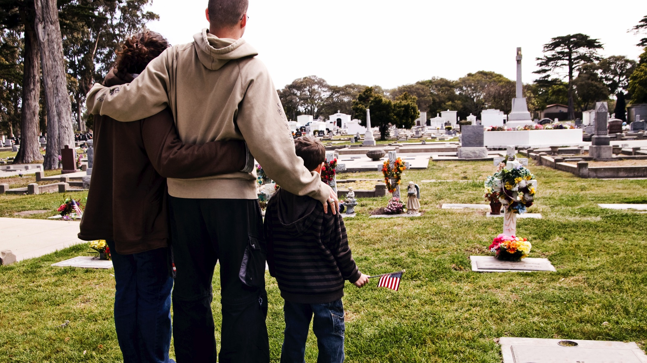
Assist with transition of the student back to school
Seek feedback from parents about their children
Offer information about community resources that may be of help to everyone in the family
Identify and anticipate potential challenges
Partner with families to support children over time
Provide appropriate reassurance and positive feedback
Notes:
Assist with transition of the student back to school. Help the family plan a timely return to school. Help prepare the student, their classmates (as appropriate), and school personnel for the student’s return.
Seek feedback from parents about their children. How are the children coping? What strategies do parents think will be helpful for school personnel in providing support over time? Parents can provide useful insights about what is, and is not, likely to work.
Offer information about community resources that may be of help to everyone in the family, such as mental health professionals and bereavement support groups. Suggest the family check with their pediatrician or other health-care provider for guidance and referrals. Help them think through other supports in their extended families and communities.
Identify and anticipate potential challenges. Families may need practical support (e.g. transportation, childcare). Schools can sometimes identify resources to address practical needs. Parents can often identify potential trigger situations for their children (e.g. significant dates, upcoming transitions).
Partner with families to support children over time. Let parents know they are helping the teacher and school better support their children—academically and emotionally—by providing useful information and valuable insight.
Provide appropriate reassurance and positive feedback. Identify ways students and families are already coping effectively. Families may feel both overwhelmed and unfamiliar with grief. They may not recognize the ways they are coping well because the children are still upset.

Slide 28

Fostering Peer Support - Equip Students With Skills
Provide information
Give students an opportunity to ask questions
Provide a safe environment for students to share thoughts and feelings
Offer concrete advice and practical suggestions
Notes:
Children who are uninformed or unprepared may unintentionally isolate or tease a classmate after a death. This can worsen the isolation grieving students already feel. But children naturally want to help their friends. Teachers can equip their students with the skills to support a peer. This can make a profound difference for a grieving student.
When teachers take the following steps, students are more likely to provide effective support to a grieving peer:
Provide information. Help students understand, at a very basic level, what has happened. They will be less likely to burden a grieving peer in the immediate aftermath of a death with repetitive questions.
Give students an opportunity to ask questions. Students are likely to have questions about what death is and the effect it has on children and their families. They will want to know how to be helpful to someone who is grieving. Teachers can often discuss this information with a class before the grieving student returns to school. This helps everyone feel more prepared.
Provide a safe environment for students to share thoughts and feelings. Invite students to talk about their own losses or the fears they may have about someone in their own life dying.
Offer concrete advice and practical suggestions. For example, talk about ways to start a conversation with someone who is grieving
*** Peer Support
https://grievingstudents.org/module-section/peer-support/

Slide 29

Use of Social Media by Schools Following a Death
A highly effective means to rapidly disseminate information to the school community as a whole
Offers a way to reach out to grieving families or students in the initial period after a death, if the family is not yet ready to accept calls or visitors
Offers insight into how people are responding to a death
Used to facilitate commemoration and memorialization efforts
Notes:
Social media is a powerful influence in young people’s lives. When a death of a member of the school community occurs, information can be passed quickly among students—sometimes accurate, sometimes not. Grieving students can obtain considerable support from peers and school through social media. It is important for school professionals to consider how to best adapt the use of social media when a death has occurred, and understand how to use it optimally.
Social media:
Can be a highly effective means to rapidly disseminate information to the school community as a whole. When appropriate, this outreach can include recent graduates who may have known the person who died, but are now living in other locations for work or college.
Offers a way to reach out to grieving families or students in the initial period after a death, if the family is not yet ready to accept calls or visitors.
Offers insight into how people are responding to a death. Information being shared among students and staff through social media can help inform plans to provide support to the community. Schools need to develop policies concerning the monitoring of social media. It is important to find a balance that precludes infringing on privacy but allows information expressed through social media to be acted on if necessary to preserve safety—for example, if an individual is expressing suicidal intentions.
Can be used to facilitate commemoration and memorialization efforts.
*** Social Media
https://grievingstudents.org/module-section/social-media/

Slide 30

Professional
Self-Care Focus
Notes:
Because school professionals care so deeply about students, offering support to grieving children can be both deeply gratifying and demanding. Providing support means bearing witness to students’ pain. It is critical that school professionals take care of themselves and their colleagues in ways that recognize the challenges of this work.
There are few ways to have a more meaningful and lasting impact on children than providing support as they cope with one of life’s most difficult challenges. In supporting grieving children, teachers connect with students in a powerful and qualitatively different way. It can be gratifying to see that relatively modest efforts to offer compassion and support have a dramatic effect on children. This support can help reduce the amount of time grieving children feel isolated, confused, or distressed.
*** Professional Preparation
https://grievingstudents.org/module-section/professional-preparation/

Slide 31

Possible Grief Triggers for School Staff
Past personal experience with grief
Coping with serious illness
Having a friend or family member who is ill
New concerns about loved ones
Notes:
Supporting grieving children can trigger a range of reactions in adults. This is especially true if a child’s loss is somehow similar to an adult’s personal experience. But even when the circumstances are quite different, the simple, powerful reality of a grieving child can raise thoughts, feelings, and memories concerning the adult’s own family and friends.
Examples of situations where adults may experience triggers include:
• A past personal experience with grief. School professionals who experienced the death of a parent during childhood may bring greater empathy and insight to their interactions with grieving students. They will also be more likely to experience a rekindling of their own memories.
• Coping with serious illness. An adult facing a life-changing or life-threatening illness may become more anxious about personal health and outcomes while comforting a student whose parent or sibling died of a serious illness such as cancer.
• Having a friend or family member who is ill. When someone close to a school professional is facing possible disability or death, a student’s grief may heighten worries or anticipatory grief reactions.
• New concerns about loved ones. Even when adults are not dealing with past deaths or current illnesses in their lives, the process of watching a child struggle to cope may heighten their own concerns about family and loved ones. A child’s grief can be a stark reminder that all life is fragile and uncertain.

Slide 32
Professional Self-Care in Schools
Identify friends, family, and colleagues to talk with
Seek additional support when guilt, resentment, or personal grief is strong or persistent
Consult with a school counselor, school nurse, school psychologist, school social worker, or other members of the school staff
Spiritual
Emotional
Occupational
Intellectual
Social
Physical
Creative
Wellness
Notes:
Being with children who are in distress can be unsettling for adults. We sense a vulnerability in children and naturally want to shield them from painful experiences. School staff can sustain their support for a grieving child if they look after their own wellness and arrange for assistance themselves. The following are some ways school staff can obtain support:
Identify friends, family, and colleagues to talk with. There may be times, however, when the support of family, friends, and colleagues is not the right match for the concerns at hand, or not sufficient on its own.
Seek additional support when guilt, resentment, or personal grief is strong or persistent.
Consult with a school counselor, school nurse, school psychologist, school social worker, or other members of the school staff.
*** Professional Self-Care
https://grievingstudents.org/module-section/professional-self-care/

Slide 33


Notes:
The Coalition to Support Grieving Students was convened by the New York Life Foundation and the National Center for School Crisis and Bereavement, which is led by pediatrician and childhood bereavement expert David J. Schonfeld, M.D.
The efforts of the Coalition have led to the establishment of a unified voice in ways schools can support grieving students. The www.grievingstudents.org website features a variety of training resources including videos, handouts and links to additional resources.

Slide 34

Supporting Organizational Members
Notes:
Many other prominent national and international organizations have subsequently joined the Coalition.

Slide 35
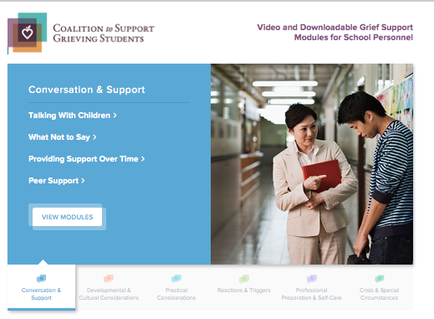
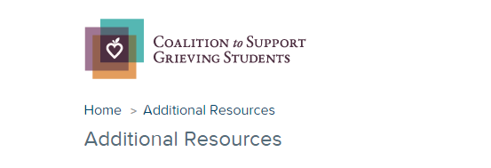
* Six topic sections contain 2 - 4 video modules with each video accompanied by downloadable handouts that summarize the major points covered.
* Links to additional resources for schools and families
www.grievingstudents.org
Notes:
The website grievingstudents.org is an innovative multimedia resource designed to empower educators and school professionals in their efforts to support grieving students.
The website offers information in six topic sections important to schools in their work to support grieving students:
Conversation and Support
Developmental and Cultural Considerations
Practical Considerations
Reactions and Triggers
Professional Preparation and Self-Care
Crisis and Other Special Circumstances
Each topic section contains 2 - 4 video modules. Each video is accompanied by downloadable handouts that summarize major points covered in the module.
Links to additional resources for schools and families are also available (https://grievingstudents.org/resources/additional-resources/) including:
Parent Booklet: After a Loved One Dies – English & Spanish
Guidelines for Responding to the Death of a Student or School Staff
Guidelines for Responding to a Death by Suicide
US DOE ERCM Express: Coping With the Death of a Student or Staff Member
Booklet: Supporting Our Students
Handout: Supporting Your Child
Teacher Training Powerpoint: Children and Bereavement: How Teachers and Schools Can Help
National and Regional Support Resources
Article: Coping With Loss
Article: School Crisis Response Initiative
Article: Talking With Children About Death

Slide 36
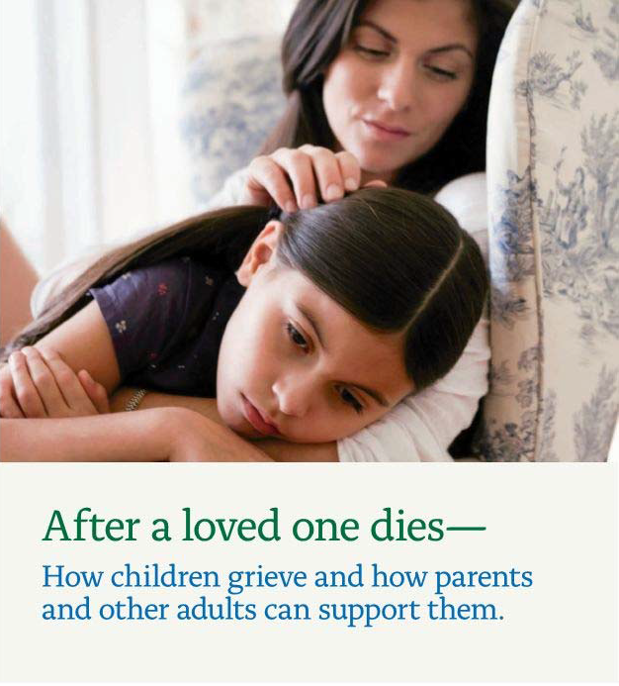

www.achildingrief.com
Schonfeld, D., and M. Quackenbush. After a Loved One Dies—How Children Grieve and How
Parents and Other Adults Can Support Them. New York, NY: New York Life Foundation, 2009.
Notes:
A free booklet for parents on how to talk to and support their children after a death can be downloaded in both English and Spanish at www.achildingrief.com.
The Grieving Student: A Teacher’s Guide is published by Brookes Publishing. Teachers can be a critical lifeline for a grieving child—and now they have a practical guidebook to help them provide sensitive support to students of all ages. Educators will get the real-world tips, strategies, and insights they need to:
explain the major concepts of death in age-appropriate ways
respond constructively to children's common feelings and behaviors after a death
initiate and maintain positive, helpful communication
learn what to say and what not to say when a child or family is grieving
use simple commemorative activities at school to help students cope with their feelings
address children's responses to different causes of death, including suicide, illness, and violence
help a child who is "stuck" in a difficult phase of grief
provide ongoing assistance when triggers of grief renew a child's sense of loss
notify and support students after a death that affects the whole school community
This guide was written by David J. Schonfeld and Marcia Quackenbush and provides additional information as well as illustrative examples to expand on the information presented in this training.

Slide 37

This presentation was developed by…
David Schonfeld, M.D., University of Southern California
Thomas Demaria, Ph.D., Long Island University – C.W. Post Campus
Marcia Quackenbush, M.S., M.F.T., M.C.H.E.S.
With the support of members of the…
National Center for School Crisis & Bereavement
Coalition to Support Grieving Students
Art Credits: William T. Demaria and Daniel Pollera
Notes:
This presentation was developed by the National Center for School Crisis and Bereavement, located at the University of Southern California School of Social Work.
August 2019 version.

Slide 38





For further information about NCSCB visit us, call us, like us, share us:
1-888-53-NCSCB (1-888-536-2722)
www.SchoolCrisisCenter.org | info@schoolcrisiscenter.org
facebook.com/schoolcrisisorg
@schoolcrisisorg
National Center for School Crisis and Bereavement

