Slide 1


Supporting Grieving Students in Schools:
Training Module - 2
Notes:
Version August 2019
This “Supporting Grieving Students in Schools” training was divided into three sections or modules so that this education program can be taught in three separate presentations.
The first module is aimed at helping school staff understand the experience of the grieving student and includes information about how children understand death and express their grief.
This is the 2nd of 3 modules. It presents practical suggestions about how school staff can initiate the conversation and offer support to the grieving student.
The third module presents practical guidance about how to coordinate resources and manage special issues while you support the grieving child.
A separate module combines key elements of all three modules in an abbreviated, single presentation.
At the bottom of some of the notes, three stars (***) will alert you about a location on the www.grievingstudents.org website where you can find video presentations and testimonies about the topic being presented.

Slide 2
Supporting the Grieving Student
This module will help school staff understand how to support the grieving student through presentations about
Barriers children and school staff face
How to initiate a conversation and what to say
How to act with a grieving child
Goals of support with a grieving child
Checking a child’s understanding of death
Cultural sensitivity
Supporting children with guilt and shame
Offering academic support proactively
Preparing students to manage grief triggers
Providing support over time
Supporting transition between grades and schools
Notes:
This module will help school staff understand how to support the grieving student through presentations about
Barriers children and school staff face
How to initiate a conversation and what to say
How to act with a grieving child
Goals of support with a grieving child
Checking a child’s understanding of death
Cultural sensitivity
Supporting children with guilt and shame
Offering academic support proactively
Preparing students to manage grief triggers
Providing support over time
Supporting transition between grades and schools
At the bottom of some of the notes, three stars (***) will alert you about a location on the www.grievingstudents.org website where you can find video presentations and testimonies about the topic being presented.

Slide 3
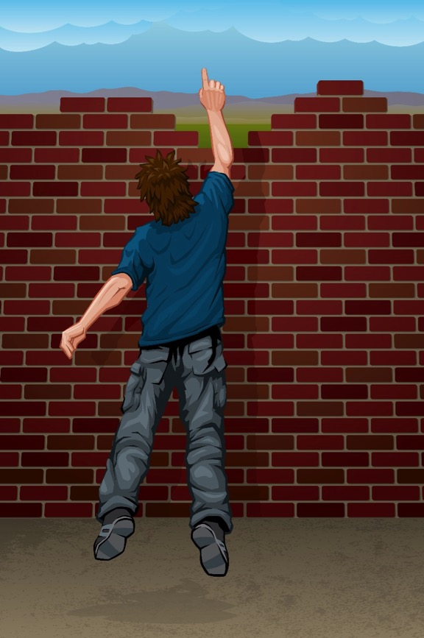
Barriers for Children in Talking About Loss
Children may…
Conclude they have done something wrong by talking about death and avoid raising the subject again
Hold in their feelings as a way to support their family
Try to look fine and reassure family they are okay when they really need support
Not fully understand death and loss
Have problems expressing their complicated feelings
Feel overwhelmed by the experience and their strong feelings
Notes:
Children often feel reluctant to talk about grief. These are some barriers that may prevent children from talking about their loss.
Children may…
Conclude they have done something wrong by talking about death and avoid raising the subject again. Children learn from an early age that conversations about death make people uncomfortable. If they ask questions, people may look away or not continue the conversation. If they speak to grieving family members after a death, adults may cry or show distress.
Hold in their feelings as a way to support their family
Try to look fine and reassure family they are okay when they really need support
Not fully understand death and loss
Have problems expressing their complicated feelings
Feel overwhelmed by the experience and their strong feelings. They may worry that they will lose control, or feel ashamed of these deep emotions. They may have complicated feelings, such as guilt or shame.
*** Why you should reach out to grieving students?
https://grievingstudents.org/module-section/talking-with-children/

Slide 4

Initiating the
Conversation
Limit personal sharing
Offer practical advice
Offer reassurance
Maintain contact
Express concern
Be genuine
Invite the conversation
Listen and observe
Notes:
Some students may still be reluctant to talk about the death. These steps can help get the conversation started:
Express concern. Let students know you’ve heard about their loss and are available to listen and offer support.
Be genuine. Children can tell when adults are authentic in their communications. For example, don’t tell a child you will miss her uncle if you did not know the man. Do tell the child you are sad she has experienced this loss.
Invite the conversation. Use simple, direct, open-ended questions. For example, ask, “How are you and your family doing?”
Listen and observe. Listen more and talk less. Share observations about students’ behavior or responses in a nonjudgmental manner.
Limit personal sharing. You can draw on personal experiences to help you better understand students, but do not need to share this with them. Keep the focus on the student.
Offer practical advice. For example, discuss ways to respond to questions from peers or adults about the death.
Offer reassurance. Without minimizing their concerns, let students know that over time they will be better able to cope with their distress, and that you will be there to help them.
Maintain contact. At first, children may not accept your invitation to talk or offers of support. Their questions will evolve over time. Remain accessible, concerned, and connected.
*** Talking With Children – Chapter 2. Strategies for starting the conversation.
*** Talking With Children – Chapter 4. Simulated encounters. Examples of four simulated encounters using actors which illustrate conversations between educators and students of different ages and demonstrate issues to consider when initiating conversations.
https://grievingstudents.org/module-section/talking-with-children/

Slide 5
What not to say…
Don’t Say This | Say this instead
“I know just what you’re going through.” | “Can you tell me more about what this has been like for you?”
“You must be incredibly angry.” | “Most people have strong feelings when something like this happens to them. What has this been like for you?”
“This is hard. But it’s important to remember the good things in life, too.” | “What kinds of memories do you have about the person who died?”
“At least he’s no longer in pain.” | “What sorts of things have you been thinking about since your loved one died?”
Notes:
Many school professionals worry they may say the wrong thing to grieving students and make matters worse. Remember, a student’s grief and pain are caused by the death, not by talking about it with a caring adult. Understanding what not to say will help you be more confident and effective when you reach out to students.
1. “I know just what you’re going through.” - You cannot know this. Everyone’s experience of grief is unique.
Say this instead: “Can you tell me more about what this has been like for you?”
2. “You must be incredibly angry.” - It is not helpful to tell people how they are feeling or ought to feel. It is better to ask. People in grief often feel many different things at different times.
Say this instead: “Most people have strong feelings when something like this happens to them. What has this been like for you?”
3. “This is hard. But it’s important to remember the good things in life, too.” - This kind of statement is likely to quiet down true expressions of grief. When people are grieving, it’s important they be allowed to experience and express whatever feelings, memories, or wishes they’re having.
Say this instead: “What kinds of memories do you have about the person who died?”
4. “At least he’s no longer in pain.” - Efforts to “focus on the good things” are more likely to minimize the student or family’s experience (see above). Any statement that begins with the words “at least” should probably be reconsidered.
Say this instead: “What sorts of things have you been thinking about since your loved one died?”
*** What not to say.
https://grievingstudents.org/module-section/what-not-to-say/

Slide 6
Don’t Say this | Say this instead
“I lost both my parents when I was your age.” | “Tell me more about what this has been like for you.”
“You’ll need to be strong now for your family. It’s important to get a grip on your feelings.” | “How is your family doing? What kinds of concerns do you have about them?”
“My dog died last week. I know how you must be feeling.” | “I know how I’ve felt when someone I loved died, but I don’t really know how you’re feeling. Can you tell me something about what this has been like for you?”
Notes:
5. “I lost both my parents when I was your age.” - Avoid comparing your losses with those of students or their families. These types of statements may leave children feeling that their loss is not as profound or important.
Say this instead: “Tell me more about what this has been like for you.”
6. “You’ll need to be strong now for your family. It’s important to get a grip on your feelings.” - Grieving children are often told they shouldn’t express their feelings. This holds children back from expressing their grief and learning to cope with these difficult feelings.
Say this instead: “How is your family doing? What kinds of concerns do you have about them?”
7. “My dog died last week. I know how you must be feeling.” - It is not useful to compare losses. Keep the focus on grieving children and their families.
Say this instead: “I know how I’ve felt when someone I loved died, but I don’t really know how you’re feeling. Can you tell me something about what this has been like for you?”

Slide 7

How to Act
• Be present and authentic
• Listen more, talk less
• Avoid trying to “cheer up” students or their families
• Accept expressions of emotion
• Show empathy
• Don’t be afraid to show emotions
• Step in to stop harmful behaviors when safety is a concern
Notes:
The following actions will increase children’s comfort, sense of safety, and ability to express themselves:
Be present and authentic.
Listen more, talk less. Keep your own comments brief. Ask open-ended questions to help students discuss their experiences, thoughts, and feelings.
Avoid trying to “cheer up” students or their families. Grief is painful. Attempts to cheer people up or bring focus to the good things in their lives are likely to communicate that you don’t want to hear students or their families talk about their pain.
Accept expressions of emotion. Expressions of sadness, anger, selfishness, or confusion are common in grieving children. These are an important part of the process. When children hear they should “toughen up” or “be strong for their families” they are less likely to fully express their feelings of grief.
Show empathy. Reflect back what you hear students say and the actions you observe. Use compassion. Avoid judgment.
Don’t be afraid to show emotions. Students usually appreciate concerned adults showing they are touched by their loss and/or how the student is feeling, such as by the adult appearing sad or becoming tearful for a moment.
Step in to stop harmful behaviors when safety is a concern.
*** Talking With Children – Chapter 3. Navigating reluctance and communicating with empathy.
https://grievingstudents.org/module-section/talking-with-children/

Slide 8

Goals of Support
Teachers can take steps to:
Decrease the sense of isolation
Increase academic function
Increase the likelihood children will talk with their families
Increase the likelihood children will talk with and receive support from their peers
Identify problems in the family that students choose to share
Connect with students on something of immense importance
Notes:
The primary goal is to offer support in the areas most likely to present challenges to students after the death of a family member or friend. Teachers can take steps to:
Decrease the sense of isolation. When teachers talk about death in the classroom, both as part of regular coursework and in response to a recent event, all students learn more about how to give and receive support.
Increase academic function. It’s common for grieving children to have difficulty concentrating and have a drop in academic performance. Teachers who talk with children and make appropriate adjustments to their class work can help them stay on course academically.
Increase the likelihood children will talk with their families. When children experience support and understanding from teachers, they may find it easier to turn to other adults, including their family members, for support.
Increase the likelihood children will talk with and receive support from their peers. Through classroom discussions and one-on-one conversations, teachers can model understanding and give all students better opportunities to listen, understand, and express feelings among their peers. Students usually appreciate concerned adults showing they are touched by the event and/or how the student is feeling, such as by the adult appearing sad or becoming tearful for a moment.
Identify problems in the family. During talks with teachers, students may reveal family issues, such as a parent struggling with depression. Teachers can help arrange appropriate referrals for the family.
Connect with students on something of immense importance. These are the kinds of lessons and conversations that can genuinely transform children’s lives.

Slide 9

Checking a Child’s Understanding of Death
Start by asking children what they understand about death
Give them simple, direct and developmentally-appropriate explanations
Ask them to explain back to you what they understand
Correct any misunderstandings or misconceptions.
Notes:
When discussing a death, it’s useful to check children’s understanding of the Four Concepts About Death reviewed in the 1st module:
Start by asking children what they understand about death.
Give them simple, direct and developmentally-appropriate explanations. Less direct terms may be confusing. For example, if children hear someone who died is in a state of eternal sleep, they may be afraid to go to sleep. Especially with younger children, it’s important to use the terms dead and died.
Ask them to explain back to you what they understand.
Correct any misunderstandings or misconceptions. These steps will help make any misunderstandings clear.
*** Concepts of Death
https://grievingstudents.org/module-section/concepts-of-death/

Slide 10

Cultural Sensitivity
Remember that the fundamental experience of grief is universal
Ask questions
Ask openly when you are unsure what would be most helpful for a family or individual
Watch out for assumptions
Be empathetic, thoughtful and sensitive
Notes:
It is understandable that school personnel may not be familiar with the rituals and expectations of every culture represented among their students. The following suggestions will help you maintain a sensitivity about grief in all cultures:
Although these are real differences, remember that the fundamental experience of grief is universal. Families from different cultures may follow specific traditions, rituals, and practices after a death. Rather than attempting to gain knowledge about every culture, teachers can aspire to achieve a general sensitivity to the unique needs of children and families coping with loss.
Ask questions.
Ask openly when you are unsure what would be most helpful for a family or individual. For example: “Can you tell me how your family and your culture recognize and cope with the death of a family member?, How does this fit with your own preferences at this time?”, “Can you help me understand how I can best be of help to you and your family?”
Watch out for assumptions. Even if you know about the common practices of a culture, this may not accurately predict how a family or individual from that culture will behave. Many people have been exposed to multiple cultures. Parents sometimes have different beliefs or practices from their children. Some families or individuals choose to follow practices of a different culture when these align better with their current beliefs or preferences. Assumptions may result in stereotypes that cloud our perceptions and make us miss opportunities to be helpful.
Be empathetic, thoughtful & sensitive. Even if you don’t know about a particular culture’s practices concerning death and grief, you can approach the family with an open mind and heart. Be guided by their responses.
*** Cultural Sensitivity
https://grievingstudents.org/module-section/cultural-sensitivity/

Slide 11

Supporting Children with Guilt and Shame
Discuss guilt and shame explicitly with grieving children
Ask about the kinds of thoughts, questions, or feelings they have been having
Describe the kinds of reactions related to guilt and shame that people often have
Normalize the experience of guilt and shame while creating a safe environment
Talk to a school mental health professional if these emotions are persistent or causing marked distress
Notes:
Shame and guilt are common reactions among grieving children—and grieving adults as well. School staff can help support children suffering from guilt and shame:
Discuss guilt and shame explicitly with grieving children
Ask about the kinds of thoughts, questions, or feelings they have been having
Describe the kinds of reactions related to guilt and shame that people often have
Normalize the experience of guilt and shame while creating a safe environment where children can speak honestly about their experiences
Talk to a school mental health professional if these emotions are persistent or causing marked distress. A referral is generally indicated if the child’s actions are known to have contributed to a death (e.g. Child accidentally discharged a gun and killed someone).
*** Guilt & Shame
https://grievingstudents.org/module-section/guilt-shame//

Slide 12
Offer Academic Support Proactively
Change an assignment
Change the focus or timing of a lesson
Reschedule or adapt tests
REACTIVE
PROACTIVE
Notes:
It’s important for school professionals to offer academic support proactively. Don’t wait for students to begin demonstrating academic challenges, or for academic challenges to become academic failure. Schools can be a source of valuable support to grieving students and should not become another source of distress.
Assist grieving students in identifying the level of academic work that feels appropriate and achievable. Some helpful modifications include:
• Change an assignment. There are many ways to adapt assignments to better match grieving students’ current ability to focus. For example, allow a student to work on a project with a partner rather than solo. Suggest a student adapt a formal research paper into a more engaging assignment, such as an oral history project or a video. Offer a student the chance to defer an oral presentation and submit a written assignment instead.
• Change the focus or timing of a lesson. A literature class might choose a different book to discuss if the one originally scheduled describes a death similar to the one a student is currently grieving. A health class on the dangers of substance abuse might be postponed, or the grieving student excused, if he has just lost a sibling to a drug overdose.
• Reschedule or adapt tests. Immediately after a death, students might be exempted from some testing, or given modifications such as testing alone in a quiet location with extra time. Scores might be omitted or weighted less in determining final grades. It’s important for teachers to find a balance between maintaining reasonable expectations and providing additional support and accommodation for grieving students. Students need to be appropriately prepared to move ahead to their next grade.
*** Impact on Learning
https://grievingstudents.org/module-section/impact-on-learning/

Slide 13

Preparing Students to Manage Grief Triggers
Identify a safe space or location where the student can go
Provide the child with the name of an adult he or she can see when feeling upset or wishing to talk
Set up procedures that allow the student to obtain support
Allow the child to call a parent or family member
Give permission and encouragement for the child to speak with other school staff
Offer private time to talk over feelings, questions, or other concerns
Notes:
As discussed in the 1st module, grief triggers are most common in the first few months after the death, but may happen at any time. School professionals can prepare students with information about grief triggers, proactively establish a safety plan with grieving students, and approach potentially difficult classroom lessons or activities with increased awareness. This creates a more supportive classroom environment that is appreciated by all students.
Support from teachers and schools can help students move through these experiences in a positive and productive way. Ideally, there will be a chance to explain proactively to grieving children that it is fairly common for such triggers to occur. Reassure them that, while intense, the immediate distress will pass. School professionals can work with a child to develop a plan for grief triggers.
Options include:
• Identify a safe space or location where the student can go. This might be the library, a study hall, a nearby classroom, or the office of the school counselor, school nurse, school psychologist, or school social worker.
• Provide the child with the name of an adult he or she can see when feeling upset or wishing to talk.
• Set up procedures that allow the student to obtain support, such as a signal or statement that doesn’t draw attention but does allow the student to leave the classroom. It’s difficult for children to ask for help and expose their vulnerabilities in front of peers when they are already feeling overwhelmed.
• Allow the child to call a parent or family member.
• Give permission and encouragement for the child to speak with other school staff including the school counselor, school nurse, school psychologist, or school social worker.
• Offer private time to talk over feelings, questions, or other concerns.
When children know there is a plan in place to deal with grief triggers, they feel less trapped when they occur. If children know they can leave without drawing attention to themselves, they become less anxious. Their distress passes more quickly, and they rarely need to leave the classroom. They are more likely to remain in class and be available for learning.
*** Grief Triggers
https://grievingstudents.org/module-section/grief-triggers/

Slide 14

Anticipate & Minimize Triggers
Expect that triggers may occur around holidays, Mother’s Day and Father’s Day, the child’s birthday, the birthday of the deceased, or the anniversary of the person’s death
Introduce class activities in a way that acknowledges absences and offers alternatives (example: Mother’s Day card)
Make an effort to reach out to grieving students at school events where the absence of a loved one may be especially noticeable
Introduce subjects such as serious illness, accidental death, war, or violence with sensitivity
Notes:
When possible, it’s helpful to anticipate and minimize grief triggers. Here are some steps that will help:
• Expect that triggers may occur around holidays, Mother’s Day and Father’s Day, the child’s birthday, the birthday of the deceased, or the anniversary of the person’s death. Children and their families may be able to suggest dates that may be difficult.
• Introduce class activities in a way that acknowledges absences and offers alternatives. Example: “For this Father’s Day activity, I’d like you to focus on your father or another important male adult in your life— someone who cares for you and has provided support. If your father is not living, or he does not live with you, you can still complete this activity with him in mind if you wish.”
• Make an effort to reach out to grieving students at school events where the absence of a loved one may be especially noticeable (e.g. performances, sporting events, science fairs).
• Introduce subjects such as serious illness, accidental death, war, or violence with sensitivity. Recognize that students in your class may have lost a family member or close friend in one of these ways.

Slide 15
Providing Support Over Time
One day?
One week?
One month?
One year?
Lifetime?
Notes:
School professionals play a unique role in supporting grieving students both in the immediate aftermath of a loss and over time. Children do not adjust to a major loss in a matter of days, weeks, months or a year, but over a lifetime.
The second year after a death is often more difficult than the first. School staff can play a vital role by offering students ongoing understanding and support that can help them make sense of their experiences and stay productive and positive in their lives.
*** Providing Support Over Time
https://grievingstudents.org/module-section/providing-support-over-time/

Slide 16
Supporting Transitions
Middle School
Team
High School
With the student’s knowledge and the family’s permission, school professionals can communicate the student’s needs and describe strategies that have been effective in providing support
The team can explore ways to provide some constancy in the support the student receives
The school team can also help the family identify ways to prepare the new school to best support their child
Notes:
Transitions between schools—and even between grades—can be both exciting and stressful for all students. There may be a change in teachers, routines, rules, schedules, and peer groups. The academic curriculum may be more demanding. For grieving students, these stressors can be more severe. They are particularly vulnerable at times of transition. The person who died may have been someone who provided valuable guidance or support at such times—a sister who offered advice on navigating a new social network, a dad who was there to listen with compassion when changes felt overwhelming. Feelings of grief and loss may be accentuated.
The school team can help grieving students during transitions between grades in the same school, or during promotions to other schools in the following ways:
With the student’s knowledge and the family’s permission, school professionals can communicate to the new school or grade the student’s needs and describe strategies that have been effective in providing support. When a student is changing grades or classrooms in the same school, the information can be shared with the new teachers. Parents often may not realize that this information is not automatically shared with a new school.
The team can explore ways to provide some constancy in the support the student receives. Perhaps the student will continue to meet regularly with a school counselor, be invited to check in with a favorite teacher, or continue to receive additional support from the coach.
The school team can also help the family identify ways to prepare the new school to best support their child. In some cases, students and families may benefit from meeting with the new team before the start of the new year to discuss options for ongoing support.
*** Coordinating Services & Supporting Transitions
https://grievingstudents.org/module-section/coordinating-services-supporting-transitions/

Slide 17

This presentation was developed by…
David Schonfeld, M.D., University of Southern California
Thomas Demaria, Ph.D., Long Island University – C.W. Post Campus
Marcia Quackenbush, M.S., M.F.T., M.C.H.E.S.
With the support of members of the…
National Center for School Crisis & Bereavement
Coalition to Support Grieving Students
Art Credits: William T. Demaria and Daniel Pollera
Notes:
This presentation was developed by the National Center for School Crisis and Bereavement, located at the University of Southern California School of Social Work.
August 2019 version.

Slide 18





For further information about NCSCB visit us, call us, like us, share us:
1-888-53-NCSCB (1-888-536-2722)
www.SchoolCrisisCenter.org | info@schoolcrisiscenter.org
facebook.com/schoolcrisisorg
@schoolcrisisorg
National Center for School Crisis and Bereavement

Slide 19


Notes:
The Coalition to Support Grieving Students was convened by the New York Life Foundation and the National Center for School Crisis and Bereavement, which is led by pediatrician and childhood bereavement expert David J. Schonfeld, M.D.
The efforts of the Coalition have led to the establishment of a unified voice in ways schools can support grieving students. The www.grievingstudents.org website features a variety of training resources including videos, handouts and links to additional resources.

Slide 20
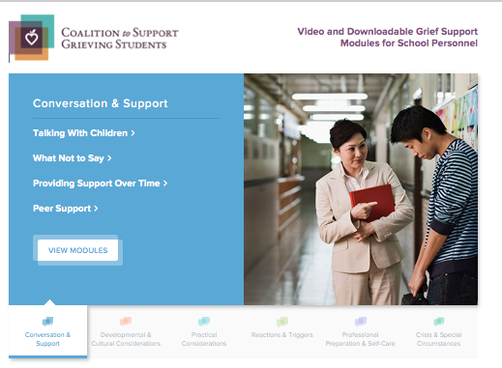
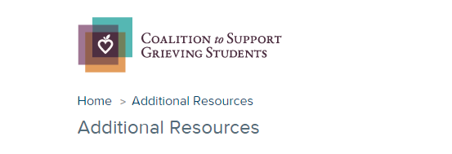
* Six topic sections contain 2 - 4 video modules with each video accompanied by downloadable handouts that summarize the major points covered.
* Links to additional resources for schools and families
www.grievingstudents.org
Notes:
The website grievingstudents.org is an innovative multimedia resource designed to empower educators and school professionals in their efforts to support grieving students.
The website offers information in six topic sections important to schools in their work to support grieving students:
Conversation and Support
Developmental and Cultural Considerations
Practical Considerations
Reactions and Triggers
Professional Preparation and Self-Care
Crisis and Other Special Circumstances
Each topic section contains 2 - 4 video modules. Each video is accompanied by downloadable handouts that summarize major points covered in the module.
Links to additional resources for schools and families are also available (https://grievingstudents.org/resources/additional-resources/) including:
Parent Booklet: After a Loved One Dies – English & Spanish
Guidelines for Responding to the Death of a Student or School Staff
Guidelines for Responding to a Death by Suicide
US DOE ERCM Express: Coping With the Death of a Student or Staff Member
Booklet: Supporting Our Students
Handout: Supporting Your Child
Teacher Training Powerpoint: Children and Bereavement: How Teachers and Schools Can Help
National and Regional Support Resources
Article: Coping With Loss
Article: School Crisis Response Initiative
Article: Talking With Children About Death

Slide 21
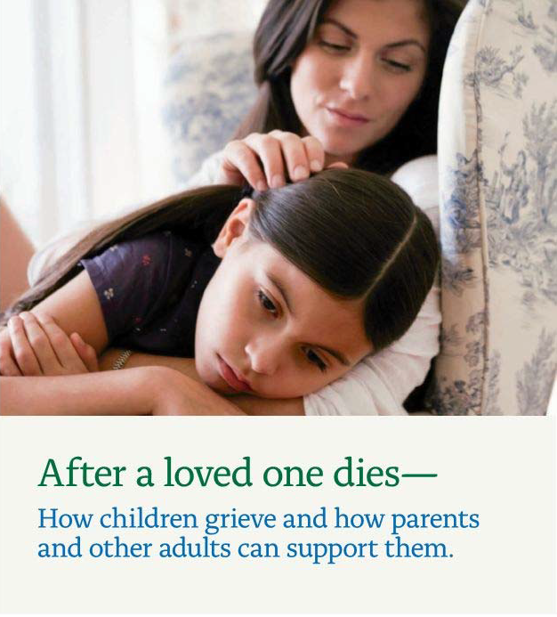

www.achildingrief.com
Schonfeld, D., and M. Quackenbush. After a Loved One Dies—How Children Grieve and How
Parents and Other Adults Can Support Them. New York, NY: New York Life Foundation, 2009.
Notes:
A free booklet for parents on how to talk to and support their children after a death can be downloaded in both English and Spanish at www.achildingrief.com.
Those looking for more detailed information may wish to read The Grieving Student: A Teacher’s Guide, published by Brookes Publishing. Teachers can be a critical lifeline for a grieving child—and now they have a practical guidebook to help them provide sensitive support to students of all ages. Educators will get the real-world tips, strategies, and insights they need to:
explain the major concepts of death in age-appropriate ways
respond constructively to children's common feelings and behaviors after a death
initiate and maintain positive, helpful communication
learn what to say and what not to say when a child or family is grieving
use simple commemorative activities at school to help students cope with their feelings
address children's responses to different causes of death, including suicide, illness, and violence
help a child who is "stuck" in a difficult phase of grief
provide ongoing assistance when triggers of grief renew a child's sense of loss
notify and support students after a death that affects the whole school community
This guide was written by David J. Schonfeld and Marcia Quackenbush and provides additional information as well as illustrative examples to expand on the information presented in this training.

