Slide 1


Supporting Grieving Students in Schools:
Training Module - 1
Notes:
Version August 2019
This “Supporting Grieving Students in Schools” training was divided into three sections or modules so that this education program can be taught in three separate presentations.
The first module will help school staff understand the experience of the grieving student and includes information about how children understand death and express their grief.
The second module presents practical suggestions about how school staff can initiate the conversation and offer support to the grieving student.
The third module presents practical guidance about how to coordinate resources and manage special issues while you support the grieving child.
A separate module combines key elements of all three modules in an abbreviated, single presentation.
At the bottom of some of the notes, three stars (***) will alert you about a location on the www.grievingstudents.org website where you can find video presentations and testimonies about the topic being presented.

Slide 2
Understanding the Grieving Student
This module will help school staff be better prepared to support grieving students through presentations about
Children’s understanding of death
How grief is experienced in children and adolescents
How children show their grief
Reactions of children to loss
Shame and guilt following a death
Impact of grief on learning
Types of losses
Grief triggers
How grief will occur over time
Notes:
Teachers and schools already have a lot of work to do. Sometimes they wonder whether they should take on the additional task of supporting bereaved children and helping all students understand death and grief.
The information provided in this module will help school staff be better prepared to support the grieving student by presentations about:
Children’s understanding of death
How grief is experienced in children and adolescents
How children show their grief
Reactions of children to loss
Shame and guilt following a death
Impact of grief on learning
Types of losses
Grief triggers
How grief will occur over time
Throughout this presentation, the term “children” will be used to refer to school-age children of all ages, including adolescents, unless otherwise indicated.

Slide 3
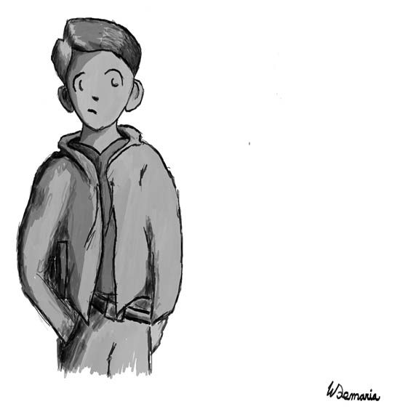
Loss is common in the lives of children
Loss is common in the lives of both younger children and adolescents
About 5% will face the death of a parent by age 16
Almost all children experience the death of an important person in their lives
It’s likely you work with grieving children every day, even if you don’t see any children who appear to be grieving
Notes:
Unfortunately, loss is common in the lives of both younger children and adolescents, and this often includes the loss of someone very close. About 5% will face the death of a parent by age 16. Studies show that before they reach adulthood, almost all children will experience the death of an important person in their lives. For example, in a survey of students in two midwestern high schools, 90% reported the death of a family member, relative or someone they cared about; and 40% reported the death of a close friend their own age.
It’s likely you work with grieving children every day, even if you don’t see any children who appear to be grieving.

Slide 4
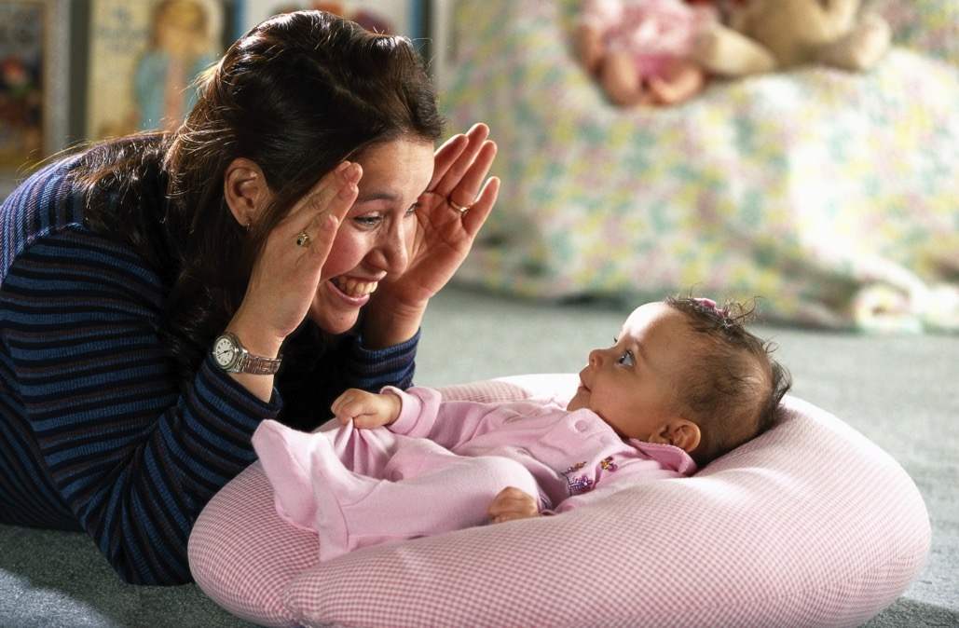
Between Six and Twelve Months of Age
Children Begin to Understand Separation & Loss
recognize that even when a person is not in their immediate view, the person exists elsewhere
may become distressed at the absence of an important person
Play “peekaboo” wherein they fix their attention on someone, then experience a brief separation
This is followed by heightened awareness and concern, then relief and joy at the reunion
“Peekaboo”
Notes:
Adults don’t usually realize that from very early on in life, children develop an awareness of separation and loss and seek to engage adults in a dialogue about this.
Between six and twelve months of age, for example, infants begin to develop object-permanence, and they begin to develop object permanence and they begin to:
recognize that even when a person is not in their immediate view, the person exists elsewhere.
may become distressed at the absence of an important person.
Infants this age all over the world begin to play the game we call peekaboo in the United States wherein they fix their attention on someone, then experience a brief separation. This is followed by heightened awareness and concern, then relief and joy at the reunion. This may be the first dialogue about loss and death children seek with adults. The translation of peekaboo from Old English is “alive or dead.”

Slide 5

Four concepts about death
1. Death is irreversible
2. All life functions end completely at the time of death
3. Everything that is alive eventually dies
4. There are physical reasons someone dies
Notes:
In order for children to understand and cope with a personal loss, young children need to learn four concepts.
1. Death is irreversible
2. All life functions end completely at the time of death
3. Everything that is alive eventually dies
4. There are physical reasons someone dies
Most children come to understand these concepts between ages 5 and 7. Younger children can be helped to understand these concepts, especially once they have experienced a close personal loss. While older children and adolescents usually understand the four concepts more fully than younger children, they are also likely to have questions related to these concepts when a death touches them in some way. They may wonder if they were responsible in some way or worry that others they care about will die soon. If they have not previously experienced a death, accepting the true inevitability of death can be painful and confusing.
Children of any age may find comfort in a family’s faith-based beliefs. However, some religious concepts may be too abstract for young children. In addition to a family’s faith based beliefs—what happens to a person’s spirit after death, for example—it is important for children to understand the physical realities about what happens to the body. This includes the Four Concepts About Death. Teachers in non-religious schools can encourage children who ask questions related to their faith or religion about death to discuss their questions with family members.
The Four Concepts About Death are also a useful framework for explaining death to children with intellectual disabilities. Their understanding of the concepts will usually be on a level commensurate with their level of general cognitive functioning. Even if they cannot fully comprehend the concepts or communicate their understanding, they are likely to be deeply affected by a close personal loss and benefit from efforts to help them better understand.
*** Concepts of Death
https://grievingstudents.org/module-section/concepts-of-death/

Slide 6

Death is irreversible
Children may view death as temporary separation
Adults may reinforce this belief
Understanding this concept allows children to begin to mourn
Notes:
Children need to understand that death is irreversible. Children often see cartoon and TV characters who “die” and come back to life. Children may view death as a temporary separation and have no reason to begin the mourning process. They may even be angry at the person for not contacting them or returning for important occasions. Adults may reinforce this belief such as when they describe death as “going on a long journey.” An essential first step in the mourning process is understanding and accepting that the loss is permanent.
Understanding this concept allows children to begin to mourn.

Slide 7
All life functions end completely at the time of death
Children may worry that the person who died is
Cold • In pain
Afraid • Lonely
Hungry
Understanding this concept helps children understand that the person who died is not suffering
Notes:
Children need to understand that all functions end completely at the time of death. Very young children initially view all things as alive—toys, rocks, cars. Adults may add to this confusion when they use phrases such as, “The car died.” As they grow older, children will understand that inanimate objects are not alive, but they may still be confused at times. A robot may seem alive, a tree may not. Children may assume a person who has died doesn’t move because there is no room in the coffin. If children are asked to draw a picture or write a note to put in the coffin, they may assume the person who died will see their work. They may believe the deceased will see how dark it is in the coffin, or hear the sound of dirt falling on the casket. Children may worry that the person who died is suffering—cold, afraid, hungry, in pain, or lonely.
Understanding this concept helps children understand that the person who died is not suffering.

Slide 8
Everything that is alive eventually dies
Children may believe they and their loved ones will never die
If children don’t see death as inevitable, they may wonder why a particular death occurred
Misunderstanding can lead to guilt or shame
Understanding this concept makes it less likely that children will associate death with guilt and shame
Notes:
Children may assume they and their loved ones will never die. Some parents reassure their children that they will always be available to take care of them. They may tell their children they don’t need to worry about dying. It is understandable that parents want to shield their children from death, but once a death occurs in a child’s life, these messages can be troubling and confusing. If children don’t see death as inevitable, they may wonder why a particular death occurred. Often they conclude it is because of something bad they did, or something they failed to do. This misunderstanding can lead to guilt. Or the child may also believe it was because of something the deceased did or didn’t do. This can lead to shame.
Understanding this concept makes it less likely that children will associate death with guilt and shame.

Slide 9
There are physical reasons someone dies
If children don’t understand the real reason a person died, they are more likely to create explanations that add to guilt or shame
Adults can help children understand the physical cause of death:
~ Use brief, simple language
~ Avoid graphic details
Understanding this concept helps minimize possible confusion and feelings of guilt and shame
Notes:
If children don’t understand the real reason a person died, they are more likely to create explanations that create confusion and add to guilt or shame. Adults can help children understand the physical cause of a death when they use brief simple language at a developmentally appropriate level and provide enough information while avoiding graphic details so children feel they understand what happened.
Understanding this concept helps minimize possible confusion and feelings of guilt and shame.

Slide 10

Grief Is Different for Each Child Based on…
• Personal relationship or perceived connection with the deceased
• Prior experience with loss
• Age and level of understanding about death
• Preexisting coping mechanisms
• Method of expressing strong emotions
• Available support systems
• Level of empathy for the needs of others
Notes:
At some level, individuals who are grieving have similar types of needs—such as for acknowledgment, understanding, and support. At another level, however, grief is quite personal. Each student’s personal reactions are likely to be quite varied.
Grief Is different for each child based on their:
Personal relationship or perceived connection with the deceased
Prior experience with loss
Age and level of understanding about death
Preexisting coping mechanisms
Method of expressing strong emotions
Available support systems
Level of empathy for the needs of others

Slide 11
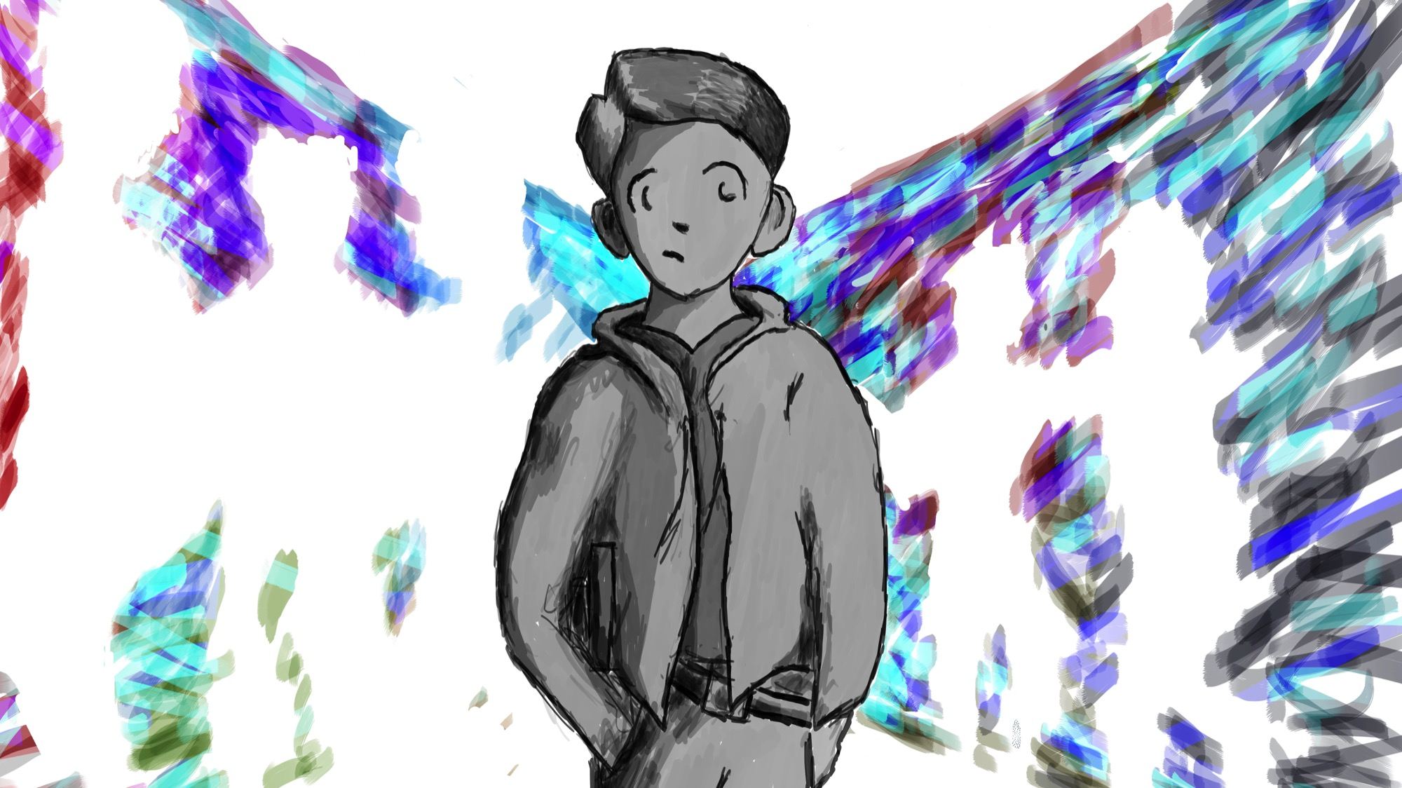
Deepest Impact of Grief Experienced by Students Who:
Were family members or relatives of the deceased
Were friends of the deceased or friends of a family member of the person who died
Had a complicated or difficult relationship with the deceased
Believed they were somehow responsible or contributed in some way, even indirectly, to the death
Shared a relevant affiliation
Experienced prior losses or emotional difficulties
Notes:
The impact of a death will vary among students based on a number of factors. Those students who have the deepest impact of grief experienced are often students who:
Were family members or relatives of the deceased
Were friends of the deceased or friends of a family member of the person who died
Had a complicated or difficult relationship with the deceased person (for example, someone who recently ended a romantic relationship with the deceased)
Believed they were somehow responsible or contributed in some way, even indirectly, to the death
Shared a relevant affiliation (for example, a situation where a student died of cancer and another student has a family member with cancer)
Experienced prior losses or emotional difficulties

Slide 12

Children experience or show their grief in different ways
Sometimes grief is showed or observed on the outside through behaviors and what children say.
Often grief is experienced on the inside and only discovered if the child is asked.
Notes:
Sometimes grief is showed or observed on the outside through behaviors and what children say. We tend to pay attention to such children. The anger and sadness in children who become oppositional or fight with their peers is quickly identified.
Often grief is experienced on the inside and only discovered if the child is asked. Such children can give us the impression that everything is going well. Children who keep their feelings on the inside do what we expect them to do and keep to themselves. They often keep up with their school work and social relationships. Children who keep their feelings inside then may need our support but do not receive the assistance they need because they do not ask for help. School staff can be surprised when children they have worked with for a entire school year share about a loss they have carried inside because no one asked them.

Slide 13

Reactions of Children to Loss
Little or No Reaction
Nonverbal Communication
Anger
Risky Behaviors
Preexisting learning, emotional, or behavioral challenges may resurface or worsen
Acting Younger
Notes:
Reactions to a death vary greatly in children.
Little or No Reaction - Some students appear to have little or no reaction at all after the death of someone important in their lives. They may actually be making an extraordinary effort to keep their emotions hidden from others. Adults in their lives may be unaware of their distress.
Nonverbal Communications - Many children express their feelings in ways other than talking. Very young children often work through their feelings during play. Older children may use creative activities such as writing, role-playing, or art to express their thoughts and feelings. While play and creative activities can provide important clues to children’s thoughts and feelings, adults should be careful not to jump to conclusions. For example, children who draw only happy scenes after a traumatic loss might give the impression they are not affected by the events. In actuality, they may instead be giving a sign that they are not yet ready to process or express their grief. Rather than interpreting children’s play or creative work, consider asking them to describe what their work is about or what story they are telling.
Anger - Children may express anger after a death and look to assign blame to others. These reactions may be an attempt to establish control in response to an overwhelming experience. Children may also direct anger toward the person who died. They may feel abandoned, or be angry about negative consequences and secondary losses that resulted from the death. It is important to normalize feelings of anger and encourage grieving children to express their feelings in ways that aren’t harmful. When children understand that people often feel angry after a death, they are less likely to feel guilty or ashamed of their feelings.
Risky Behaviors - Older children and teens may engage in risky behaviors such as drinking alcohol or using other substances, engaging in risky sexual activity, or participating in violent or delinquent behavior. This often reflects their struggle to master an increase in feelings of personal vulnerability after the death of someone close to them. Invite these students to think about possible links between the risks they are taking and their feelings about their loss. When the risky behaviors persist, or when they are serious, refer students to appropriate mental health professionals.
Preexisting Challenges - Preexisting learning, emotional, or behavioral challenges may resurface or worsen after a death. Help plan extra supports from professionals within the school and community as students learn to cope with their loss.
Acting Younger - In the aftermath of a death, children may begin to act more like they did at an earlier age. Children who were comfortable with independence may become sensitive to separation from surviving family members. They may act more immature, self-centered or demanding, and be less tolerant of change.
*** Other Reactions
https://grievingstudents.org/module-section/other-reactions/

Slide 14

How children understand death
Notes:
To help children cope with loss, it is important that we understand how children understand death.

Slide 15
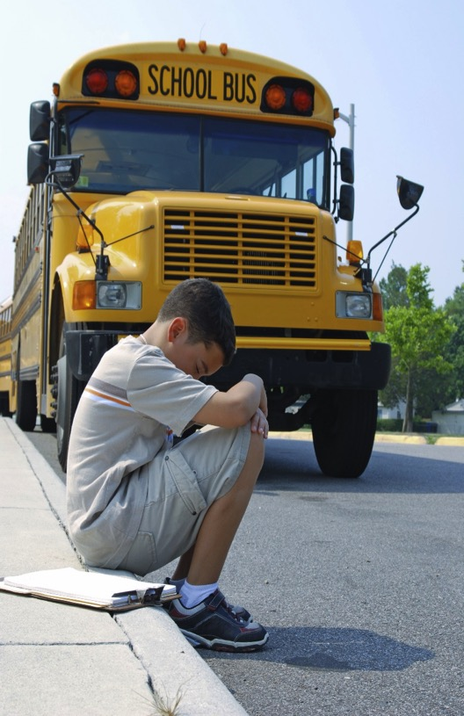
Guilt is Very Common After a Death…
When something bad happens, children often assume they have caused the problem by acting badly
Children may worry about the possibility that they will repeat their bad behavior & cause the death of someone else
The preexisting relationship with the person who died was ambivalent or conflicted
A death is preceded by a lengthy illness
There may be some logical reason to experience guilt feelings
Guilt is More Likely When…
Notes:
Guilt is very common after a death…
When something bad happens, children often assume they have caused the problem by acting badly.
Children may worry about the possibility that they will repeat their bad behavior and cause the death of someone else close. So you may see some children after a death try to act perfectly. We often respond to children’s misbehavior, but any sudden change of behavior after a death should be explored.
Guilt is more likely when…
The preexisting relationship with the person who died was ambivalent or conflicted. This would include when a parent was abusive, absent, mentally ill, drug involved, or incarcerated. It might also stem from developmentally common situations—for example, an adolescent who clashed with her father’s attempts to limit her independence.
If a death is preceded by a lengthy illness. Children (and adults) may have had moments when they wondered whether it might not be best for the person to die and be relieved of the physical suffering. This would also end some of their own emotional suffering as they anticipate the death and adjust to the needs of the sick person. These children may feel guilty for wishing for the death of someone they love.
There may be some logical reason to experience guilt feelings. For example, if a child accidentally discharged a firearm, killing a sibling. It is important to involve mental health providers, either from the school or the community, to help such children address their feelings. Through counseling they may come to appreciate that their guilt is unwarranted, or be helped to forgive themselves if they contributed to an action that resulted in a death.
*** Guilt & Shame
https://grievingstudents.org/module-section/guilt-shame/

Slide 16

Shame Can Be Experienced when Children & Adolescents Believe
Their questions or comments about the deceased make a family member or adult upset.
The person who died did something wrong that resulted in his or her death
Notes:
Another common reaction children have to a death is shame. When children withhold information about a loss or expressions of grief out of shame, they will be even more isolated in their grief.
Shame can be experienced when children believe that:
their questions or comments about the deceased make a family member or others upset. Children may fear that they have done something naughty in broaching the subject and keep their questions and feelings to themselves. This may provide reassurance to the adults in their lives that they are fine even though they continue to have questions and feelings about the death.
the person who died did something wrong that resulted in his or her death. They may then feel ashamed of their relationship with the deceased. Deaths that carry an additional stigma, such as deaths involving suicide, drug overdose, or criminal activity, are therefore even more difficult to discuss. Children and adults may choose not to even inform the school that a significant death has occurred, in part related to feelings of shame or embarrassment.

Slide 17

Impact on Learning
Difficulty concentrating and distractibility
Limitations in learning and/or remembering new facts or concepts
Failing to hand in assignments or study for exams because of reduced family supervision
Preexisting learning challenges become worse
Notes:
Temporary academic challenges are common among grieving students and should be anticipated. These may occur immediately after the death. They might also first appear weeks or even months later.
Common impacts on learning include:
Difficulty concentrating and distractibility
Limitations in learning and/or remembering new facts or concepts
Failing to hand in assignments or study for exams because of reduced family supervision
Preexisting learning challenges often become worse
Further information about accommodations and supports that can be provided by educators is discussed in the second module.
*** Impact on Learning
https://grievingstudents.org/module-section/impact-on-learning/

Slide 18

Types of Losses
Primary Loss: the death of a family member, close friend or loved one
Secondary Loss: Such things as changes in relationships, schools, family finances, and lifestyle
Cumulative Loss: Results following a number of successive losses experienced by a child over time
Notes:
There are multiple types of losses that may occur after a death. The primary loss may be the death of a family member, close friend or other loved one.
When a close family member dies, children may also experience a range of secondary losses that contribute to the difficulty of adjusting to the death. Such things as changes in relationships, schools, family finances, and lifestyle may be secondary losses. Grieving children mourn not only the loss of the person who died, but also these associated losses.
Cumulative loss results from a number of successive losses experienced by a child over time. The child often does not have the opportunity to fully process the impact of primary or secondary losses since other additional losses also occupy their attention.
*** Secondary & Cumulative Losses
https://grievingstudents.org/module-section/secondary-cumulative-losses/

Slide 19

Common Secondary Losses
• Changed relationships
• Changes in school
• Financial challenges
• Changes in lifestyle
• Changes in peer group or status
• A parent who is less available
• Loss of shared memories
• Change in future plans
• Loss of special recognition & support
• Decreased sense of security & safety
Notes:
Common secondary losses include:
• Changed relationships. Friends and associates of the deceased may no longer be a regular part of children’s lives. For example, after the death of an older sister, a student might no longer see the sister’s boyfriend, who may have served as an important role model, confidant, or source of support. Relationships that seem incidental to adults, or even to the children themselves, may be quite significant after they are lost. This is especially true for children who have limited support or are experiencing family or personal challenges.
• Changes in school. Sometimes a family must move after a death. Moving to a new school disrupts friendship networks and other supports.
• Financial challenges. When a family provider dies, there may be new and sudden financial difficulties.
• Changes in lifestyle. If there are financial challenges, the family may have to move to a smaller apartment, a less expensive neighborhood, or the home of extended family members. There may be less privacy and comfort. The child may not be able to participate in extracurricular or afterschool programs that cost money.
• Changes in peer group or status. Moving, a new school, or diminished resources can change children’s friendship networks or their status among their peers.
• A parent who is less available. A surviving parent may have to work more and have less time to spend with children. A parent who is struggling with depression or complicated grief may not be emotionally available.
• Loss of shared memories. Children feel connected to family and loved ones through shared memories about their times together. This might include private jokes, stories about the child’s early years, or shared experiences. No one else knows them in quite this way, and no one else will ever know them in this way again. Children may also lose the opportunity to learn more about their own and their family’s history.
• Change in future plans. After the death of a parent or provider, teens may not be able to follow through on plans for college or developing a career. They may not be able to afford the college or trade school they had chosen or may feel a need to get into the job market immediately to help the family financially and give up other plans. They may not have the help they had expected with the application process or choosing a school.
• Loss of special recognition and support. Children look to loved ones for support at challenging times and recognition at times of success and achievement. Without the support of the deceased, they may find achievements less rewarding and feel less motivated to pursue their interests and goals.
• Decreased sense of security and safety. After the death of a loved one, children lose the ability to count on their world being safe in the same way. If this person could die, others they love could also die.

Slide 20

Communities with Cumulative Loss
Students may have experienced the death of multiple peers and family members but do not become accustomed to such losses
Poverty and neighborhood disorganization may complicate the child’s adjustment
Children will benefit from adult guidance about how to express their thoughts and feelings, and how to cope best under these frightening circumstances
Children may turn to peers for support and engage in a range of risky behaviors to challenge their fears about their own mortality
Children benefit from being reminded of their personal resiliency and the support system they still have
School personnel can achieve a great deal by providing opportunities for grieving students to express themselves and be heard by concerned, caring, and competent adults
Notes:
Children in communities with high rates of violence often experience cumulative loss.
In these communities:
Students may have experienced the death of multiple peers and family members but do not become accustomed to such losses. Rather, they become more sensitized to loss and death. Adults too often assume these children have somehow become accustomed to these losses. They fail to recognize students’ many acute expressions of grief.
Poverty and neighborhood disorganization may complicate the child’s adjustment.
Children will benefit from adult guidance about how to express their thoughts and feelings, and how to cope best under these frightening circumstances. Children in this setting may have personal resiliency, but often lack sufficient external support to cope effectively with death. With each subsequent death, they emerge more vulnerable to the impact of future loss.
Children may turn to peers for support and engage in a range of risky behaviors to challenge their fears about their own mortality. Children who are afraid of dying from violence may place themselves in risky or violent situations in order to reassure themselves that they will survive (this may represent counter-phobic behavior and reactive risk-taking). Children afraid of dying from community violence may also join gangs if they believe that is their sole option for finding protection. Their failure to ask for support from adults in their school is often not because they don’t need it, but because they believe it is futile to ask.
Children benefit from being reminded of their personal resiliency and the support system they still have. Students in these communities may come to believe that adults are unable or unwilling to provide support after a death has occurred.
School personnel can achieve a great deal by providing opportunities for grieving students to express themselves and be heard by concerned, caring, and competent adults.
.

Slide 21

Common Grief Triggers
• Hearing a song or seeing a TV show
• Special occasions
• Transitions
• Lost opportunities
Notes:
Grief triggers are sudden unanticipated reminders of the person who died that may cause powerful emotional responses in grieving children, such as:
• Hearing a song or seeing a TV show that reminds the child about a missing family member
• Special occasions (e.g. holidays, birthdays, Mother’s or Father’s Day)
• Transitions such as graduation, starting at a new school, or moving, when the presence of a friend or family member may be particularly missed
• Lost opportunities for special interactions with the person who died such as school performances, sports events, father-daughter dances
Grief triggers catch children off guard, may make them feel out of control or embarrassed and temporarily interfere with their ability to concentrate and learn.
*** Grief Triggers
https://grievingstudents.org/module-section/grief-triggers/

Slide 22
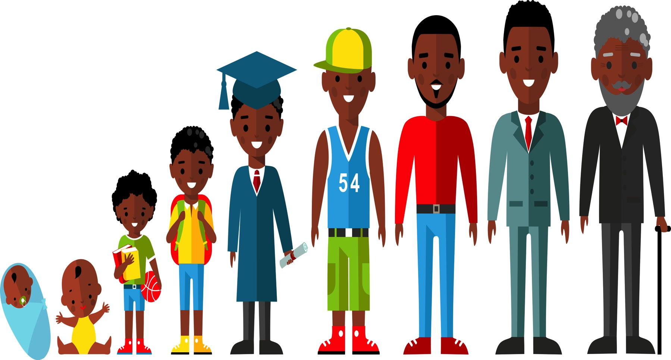
Grief Over Time
Grief proceeds on its own terms
As children grow and develop, even normative transitions and changes in their lives will remind them of the loss
As children develop, they become more capable of understanding and adjusting to their loss
Children experience grief differently over time, and often revisit deep feelings at special events and times of transition
Notes:
Grief proceeds on its own terms. There is no set time frame. There are no firm stages. The second year after a death can seem even more challenging than the first. However, this is a point where the support and concern available immediately after a death has diminished greatly—sometimes it has virtually disappeared. In many ways, children never get over a significant loss.
As children grow and develop, even normative transitions and changes in their lives will remind them of the loss. A boy whose father died while he was in elementary school may miss him acutely when he enters puberty or transitions to college, at college graduation, when he is married, and when he has children or grandchildren.
As children develop, they become more capable of understanding and adjusting to their loss. The work of grieving becomes less difficult and requires less energy. It begins as a full-time job, but becomes more of a part-time effort that allows other meaningful work and experiences to occur. Grieving lasts a lifetime, but does not need to consume a life.
Children experience grief differently over time, and often revisit deep feelings at special events and times of transition. It can be helpful when teachers make a special effort to connect with students at such moments. These may include: holidays, birthdays, moves to a new grade or school and awards and other recognition.

Slide 23

Grief in High School Juniors & Seniors
Expected to be more mature and better able to handle the concepts and consequences of a death
Difficulties concentrating may impact on their future
Ambivalence about independence & worry about need for support
Anxious about leaving family & friends behind
Feel obligated to surviving family members
Feel selfish about pursuing personal goals
Notes:
High school juniors and seniors may be especially challenged by the death of a family member or close friend because adolescences are:
Expected to be more mature and better able to handle the concepts and consequences of a death - Adults may believe that adolescents don’t need the kind of support and outreach that younger children do at the time of a death. Adolescents may even be expected to provide comfort to both parents and younger siblings, and required to take on more adult responsibilities in the family
Difficulties concentrating may impact on their future - They are coping with heightened academic demands and scrutiny. Difficulties concentrating and learning that are common in bereavement may seem to carry major implications for their future success.
Ambivalence about independence & worry about need for support - Students who are considering upcoming independence from their families—by going to college, embarking on a career, or leaving the family home—are typically ambivalent to some degree. They want separation from their parents, but also worry about how well they can live without their family’s support and comfort.
Anxious about leaving friends and family behind - They may worry that something will happen to their loved ones, or to themselves, if they don’t remain together.
Feel obligated to surviving family members – Adolescents may feel new obligations to assist a surviving parent with chores, provide emotional support, or work to help the family financially.
Feel selfish about pursuing personal goals - A plan to pursue personal goals may feel like a selfish act, or even abandonment.

Slide 24

This presentation was developed by…
David Schonfeld, M.D., University of Southern California
Thomas Demaria, Ph.D., Long Island University – C.W. Post Campus
Marcia Quackenbush, M.S., M.F.T., M.C.H.E.S.
With the support of members of the…
National Center for School Crisis & Bereavement
Coalition to Support Grieving Students
Art Credits: William T. Demaria and Daniel Pollera
Notes:
This presentation was developed by the National Center for School Crisis and Bereavement, located at the University of Southern California School of Social Work.
August 2019 version.

Slide 25





For further information about NCSCB visit us, call us, like us, share us:
1-888-53-NCSCB (1-888-536-2722)
www.SchoolCrisisCenter.org | info@schoolcrisiscenter.org
facebook.com/schoolcrisisorg
@schoolcrisisorg
National Center for School Crisis and Bereavement

Slide 26


Notes:
The Coalition to Support Grieving Students was convened by the New York Life Foundation and the National Center for School Crisis and Bereavement, which is led by pediatrician and childhood bereavement expert David J. Schonfeld, M.D.
The efforts of the Coalition have led to the establishment of a unified voice in ways schools can support grieving students. The www.grievingstudents.org website features a variety of training resources including videos, handouts and links to additional resources.

Slide 27
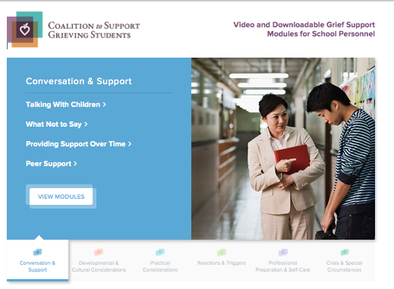
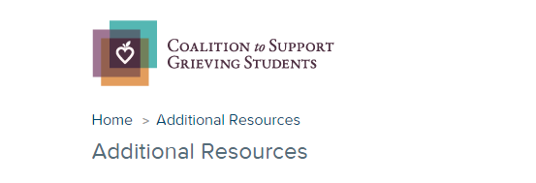
* Six topic sections contain 2 - 4 video modules with each video accompanied by downloadable handouts that summarize the major points covered.
* Links to additional resources for schools and families
www.grievingstudents.org
Notes:
The website grievingstudents.org is an innovative multimedia resource designed to empower educators and school professionals in their efforts to support grieving students.
The website offers information in six topic sections important to schools in their work to support grieving students:
Conversation and Support
Developmental and Cultural Considerations
Practical Considerations
Reactions and Triggers
Professional Preparation and Self-Care
Crisis and Other Special Circumstances
Each topic section contains 2 - 4 video modules. Each video is accompanied by downloadable handouts that summarize major points covered in the module.
Links to additional resources for schools and families are also available (https://grievingstudents.org/resources/additional-resources/) including:
Parent Booklet: After a Loved One Dies – English & Spanish
Guidelines for Responding to the Death of a Student or School Staff
Guidelines for Responding to a Death by Suicide
US DOE ERCM Express: Coping With the Death of a Student or Staff Member
Booklet: Supporting Our Students
Handout: Supporting Your Child
Teacher Training Powerpoint: Children and Bereavement: How Teachers and Schools Can Help
National and Regional Support Resources
Article: Coping With Loss
Article: School Crisis Response Initiative
Article: Talking With Children About Death

Slide 28
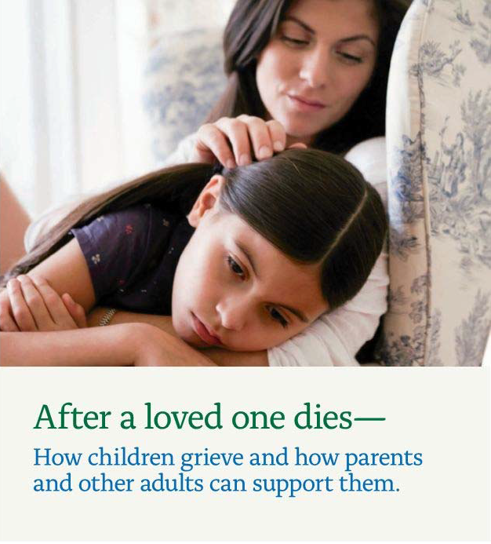
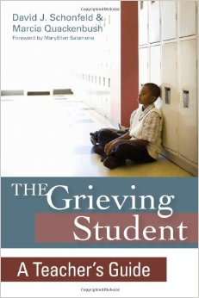
www.achildingrief.com
Schonfeld, D., and M. Quackenbush. After a Loved One Dies—How Children Grieve and How
Parents and Other Adults Can Support Them. New York, NY: New York Life Foundation, 2009.
Notes:
A free booklet for parents on how to talk to and support their children after a death can be downloaded in both English and Spanish at www.achildingrief.com.
Those looking for more detailed information may wish to read The Grieving Student: A Teacher’s Guide, published by Brookes Publishing. Teachers can be a critical lifeline for a grieving child—and now they have a practical guidebook to help them provide sensitive support to students of all ages. Educators will get the real-world tips, strategies, and insights they need to:
explain the major concepts of death in age-appropriate ways
respond constructively to children's common feelings and behaviors after a death
initiate and maintain positive, helpful communication
learn what to say and what not to say when a child or family is grieving
use simple commemorative activities at school to help students cope with their feelings
address children's responses to different causes of death, including suicide, illness, and violence
help a child who is "stuck" in a difficult phase of grief
provide ongoing assistance when triggers of grief renew a child's sense of loss
notify and support students after a death that affects the whole school community
This guide was written by David J. Schonfeld and Marcia Quackenbush and provides additional information as well as illustrative examples to expand on the information presented in this training.

